Slide 1

BookMyPG
“It’s a home away from home”

Slide 2

OUR TEAM
Group no.:20
Jasleen Kaur
19-BCA-065
Yash Agarwal 19-BCA-085
Bharti Singh
19-BCA-106
Internal Guide: Dr.Dhara Bhatt
External Guide: Jugal Prajapati

Slide 3

CONTENTS
❖ INTRODUCTION OF THE PROJECT
❖ TOOLS AND TECHNOLOGIES
❖ ADMIN PANEL
❖ USER PANEL
❖ PG OWNER PANEL
❖ REPORT

Slide 4

BookMyPg
❖
❖
BookMyPg is an online platform specifically for students to search, inquire and
choose the PG which best suits their requirements.
This website lists out all the PGs’ based on your selection criteria. The list varies
from the most affordable ones to the most luxurious ones and maintains a
centralized repository of all related information.
❖
❖
We ensure the places listed and the people looking for a stay are selected based
on careful filtering criteria so that both parties benefit and the safety of all
involved persons is ensured.
It’s a platform where users can know the facilities provided and select a PG
according to their need and budget.

Slide 5

Entities
Admin
PG Owner
User
Visitor

Slide 6

Tools And Technology
Platform:
Front End: HTML, CSS, JS, PHP 7.4
Backend: MySQL 8.0
Other tools:
Presentation tool: Microsoft Power Point 2016
Drawing tool: Edraw Max 9.0
Reports: PHP Report Maker
IDE: Apache Netbeans IDE
12.0
Server:Xampp Server

Slide 7

Admin Panel

Slide 8
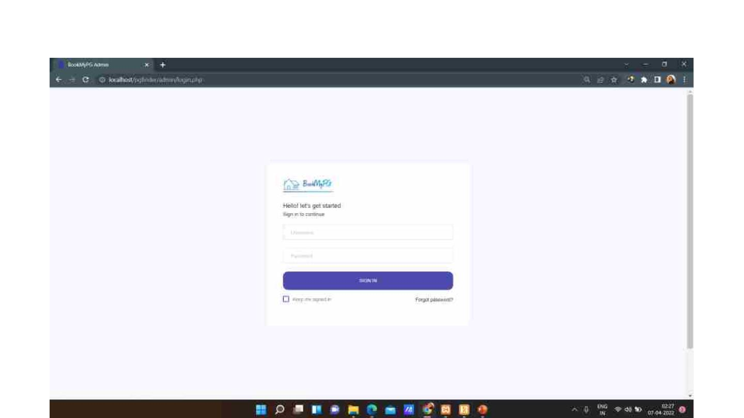
This is the login page for the admin.

Slide 9
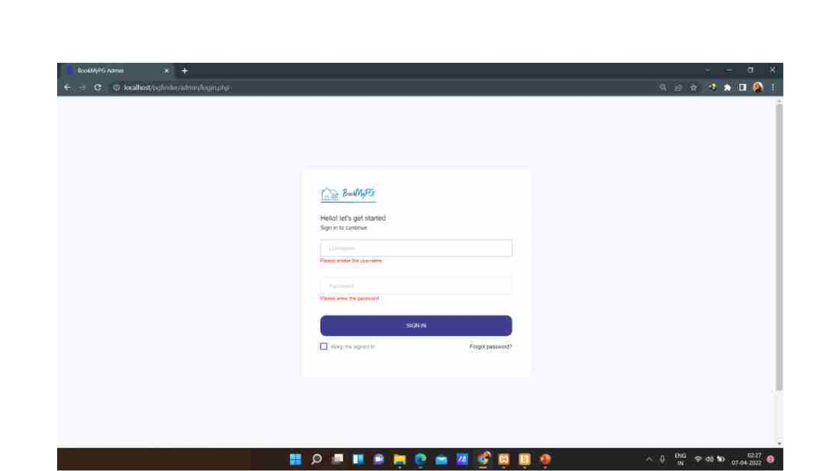
Login Page with validations.

Slide 10
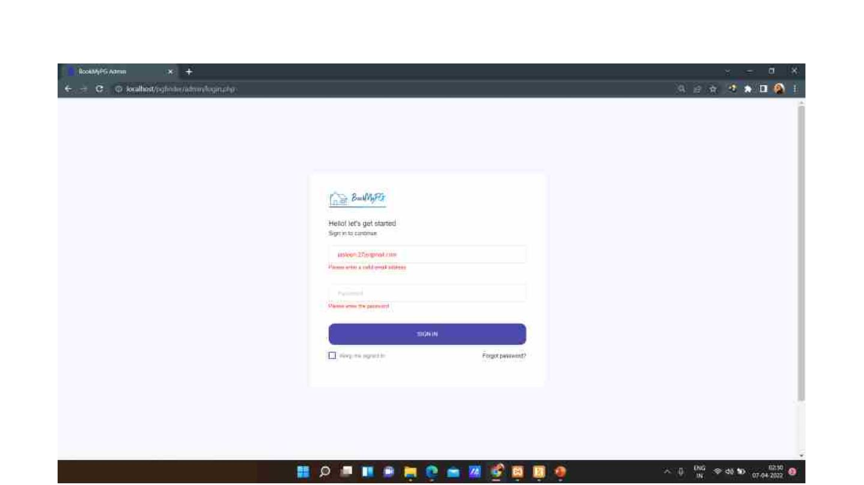

Slide 11
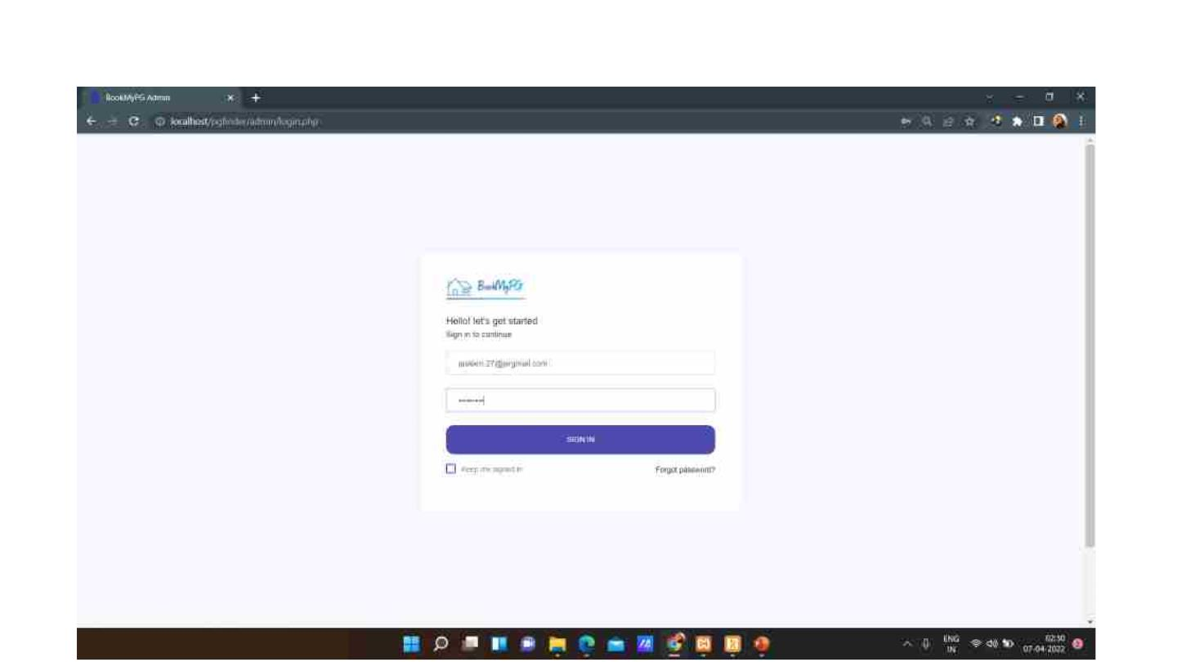
Login with valid credentials.

Slide 12
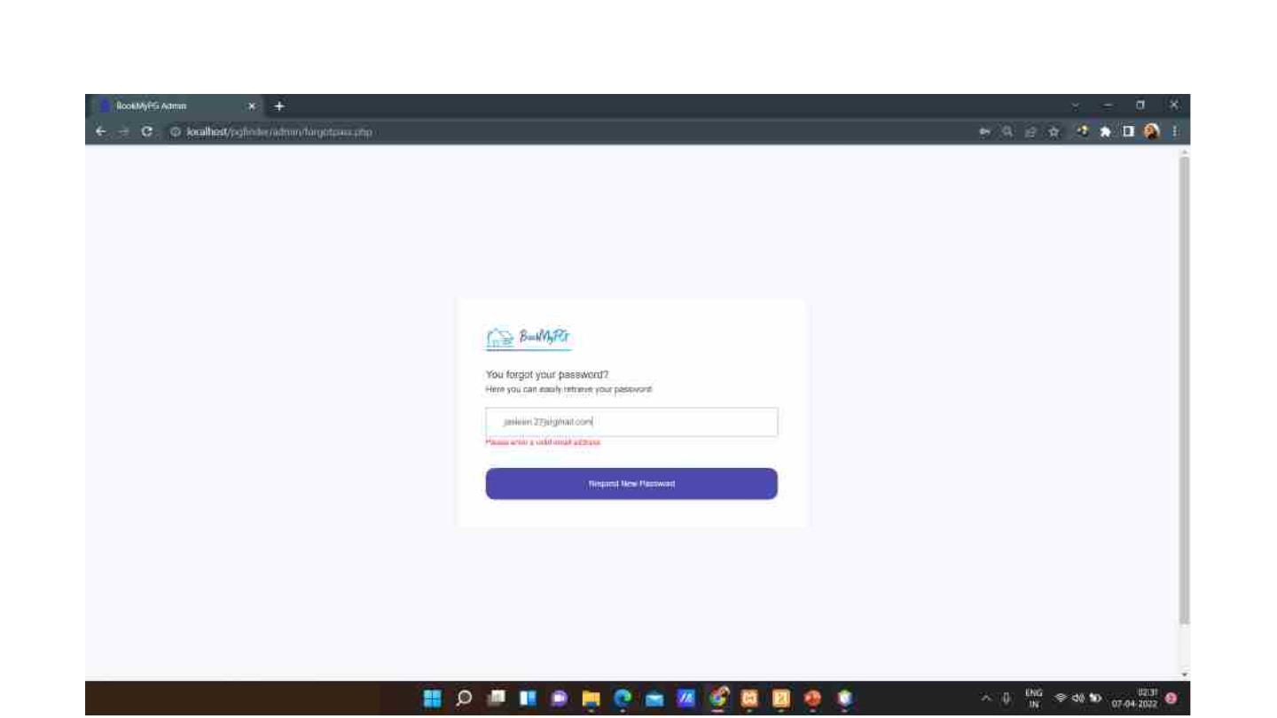
Forgot password page along with validations.

Slide 13
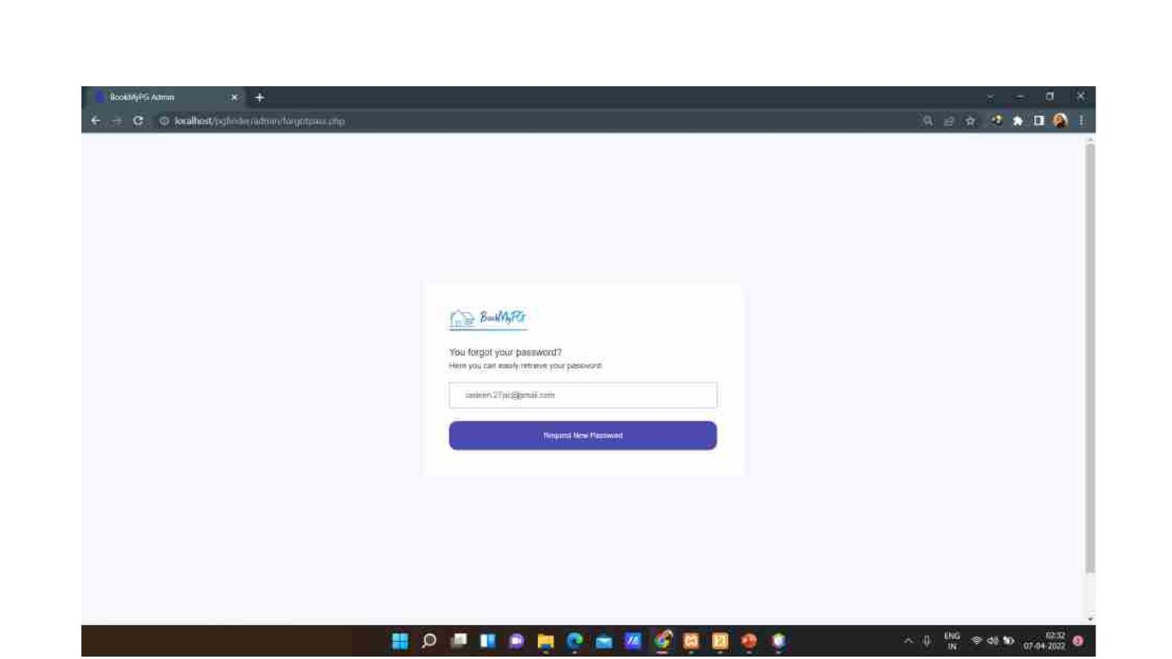
Forgot password page with valid credentials.

Slide 14
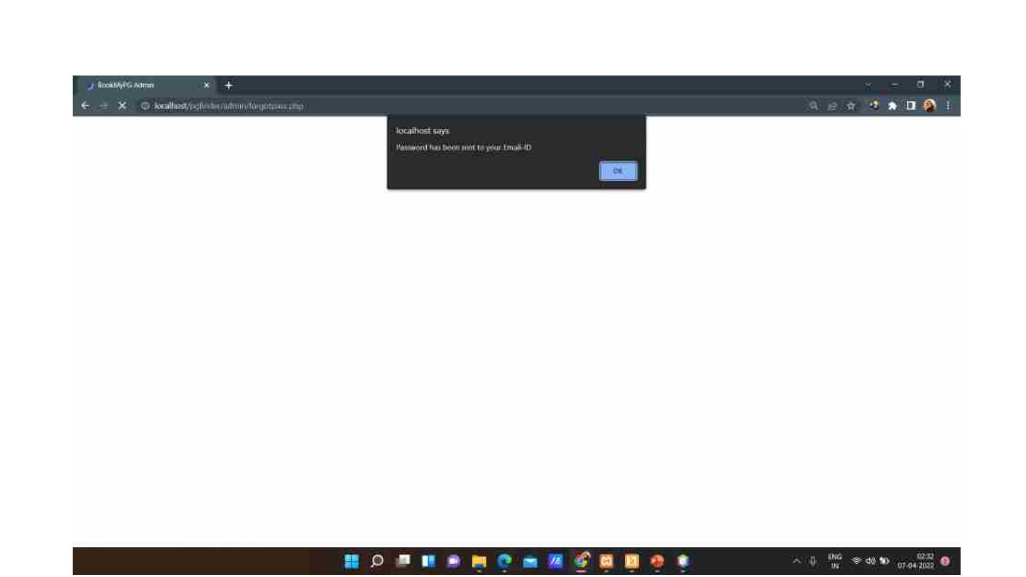
Password sent to your email id.

Slide 15
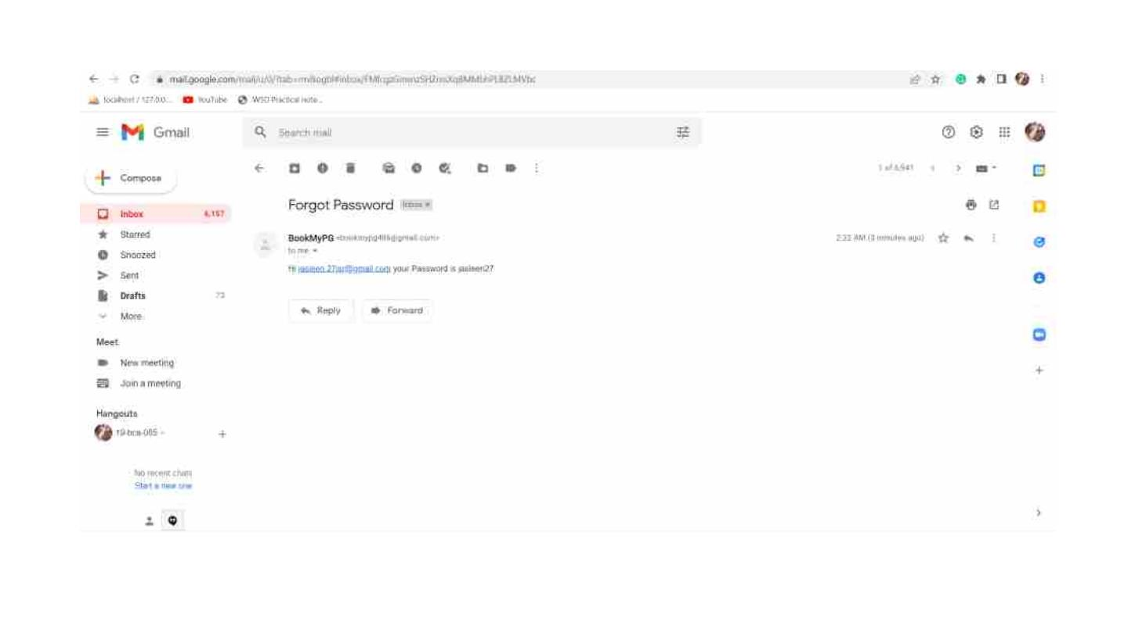

Slide 16
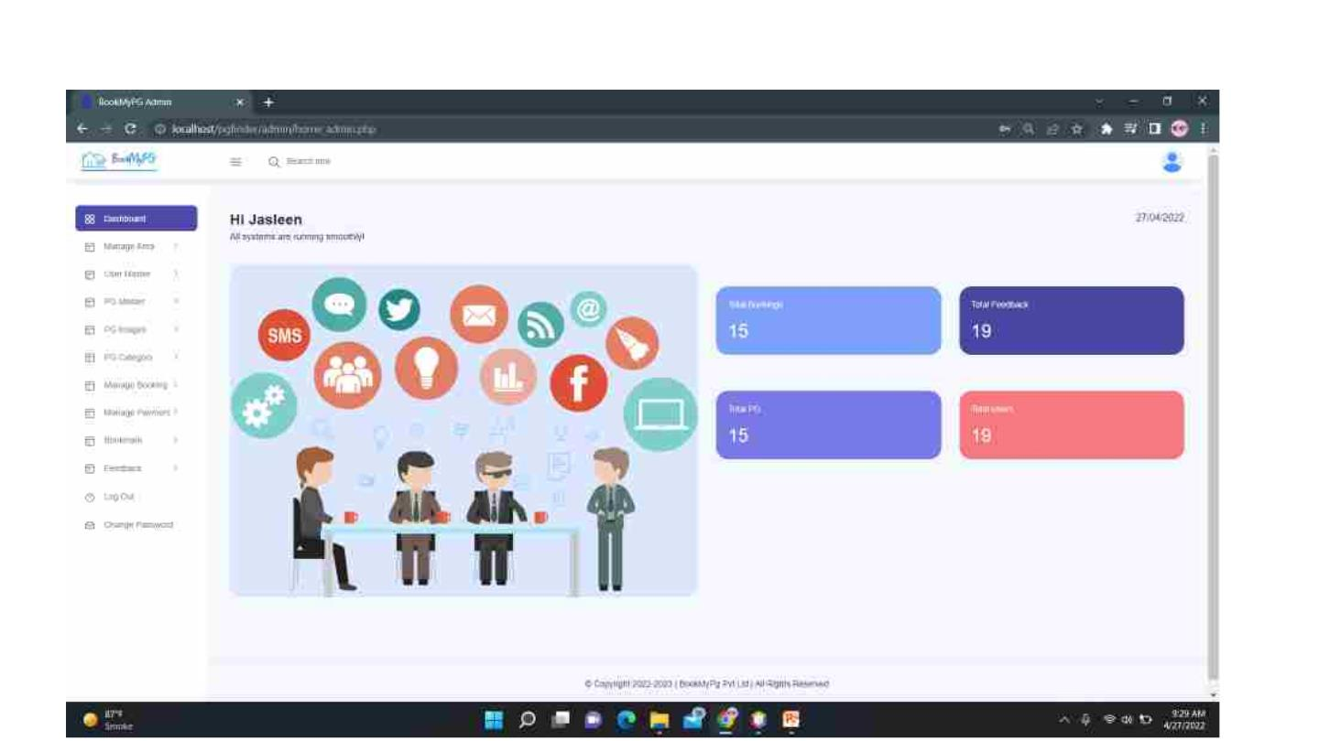
Home page for the admin.

Slide 17
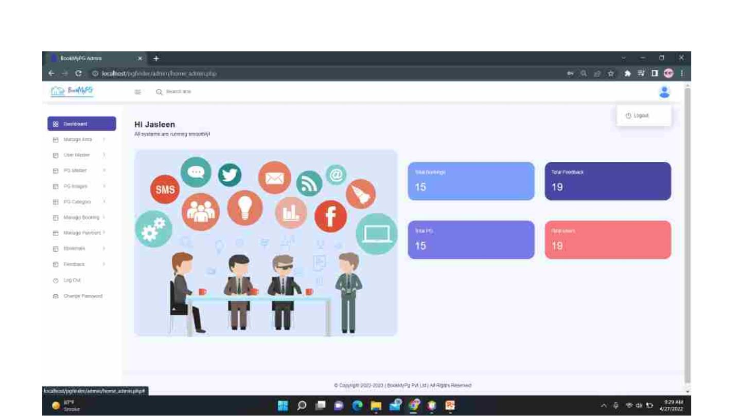
Admin can logout and change password from the home page.

Slide 18
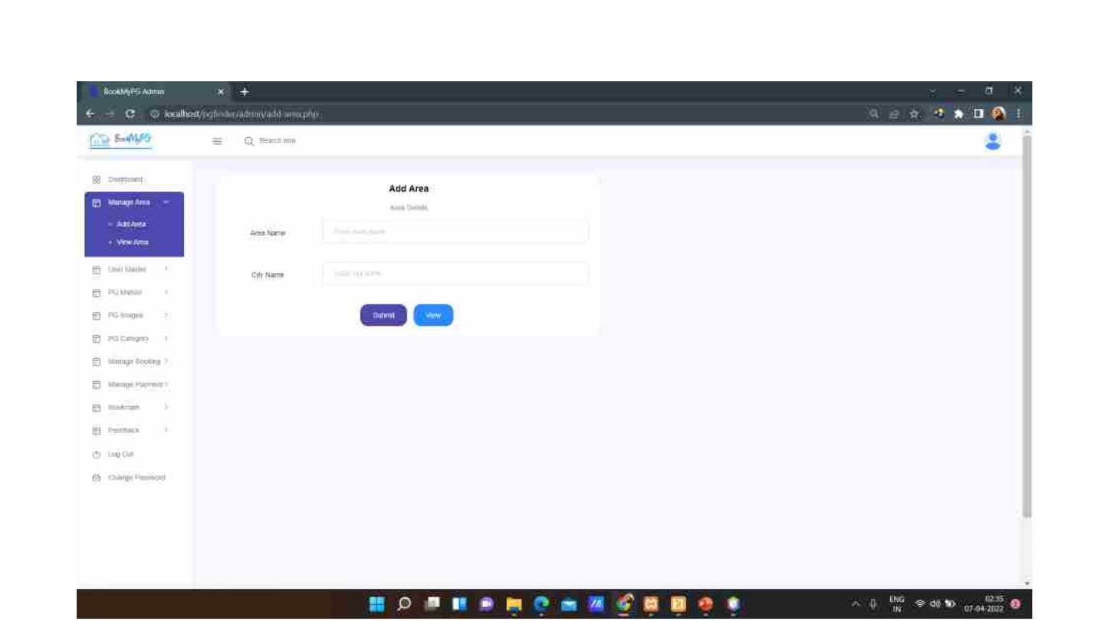
Admin can add area.

Slide 19
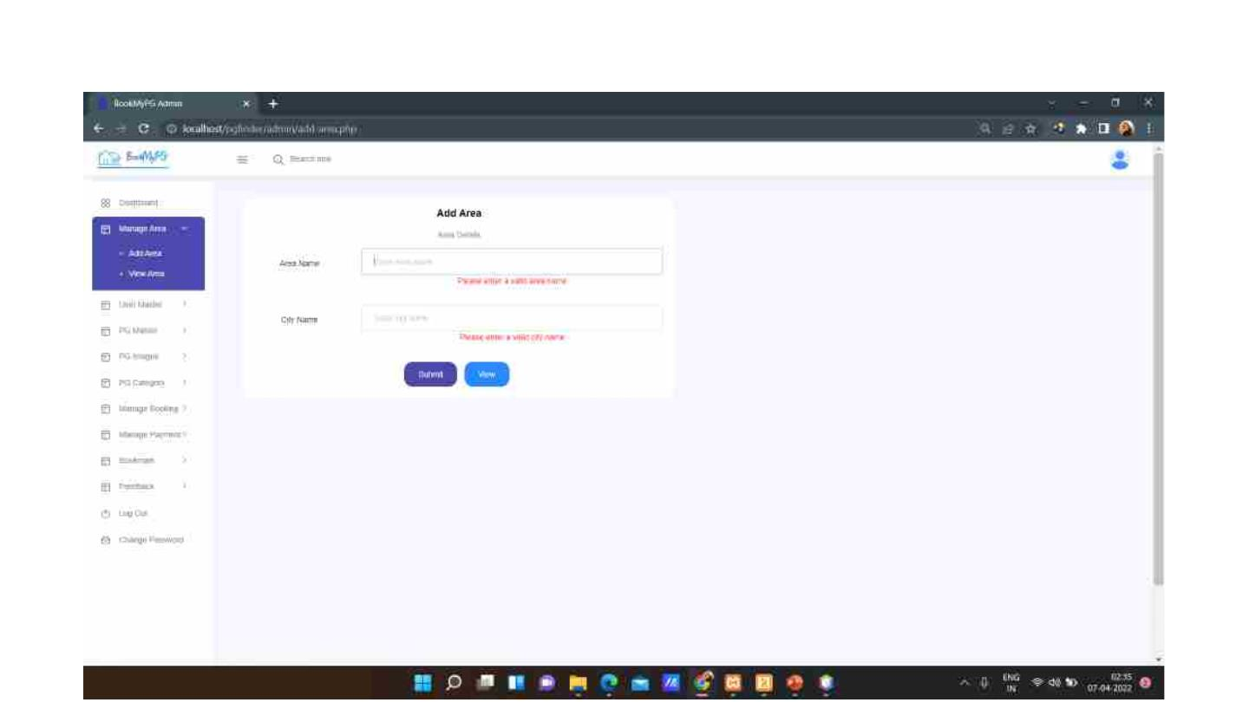
Area page with validations.

Slide 20
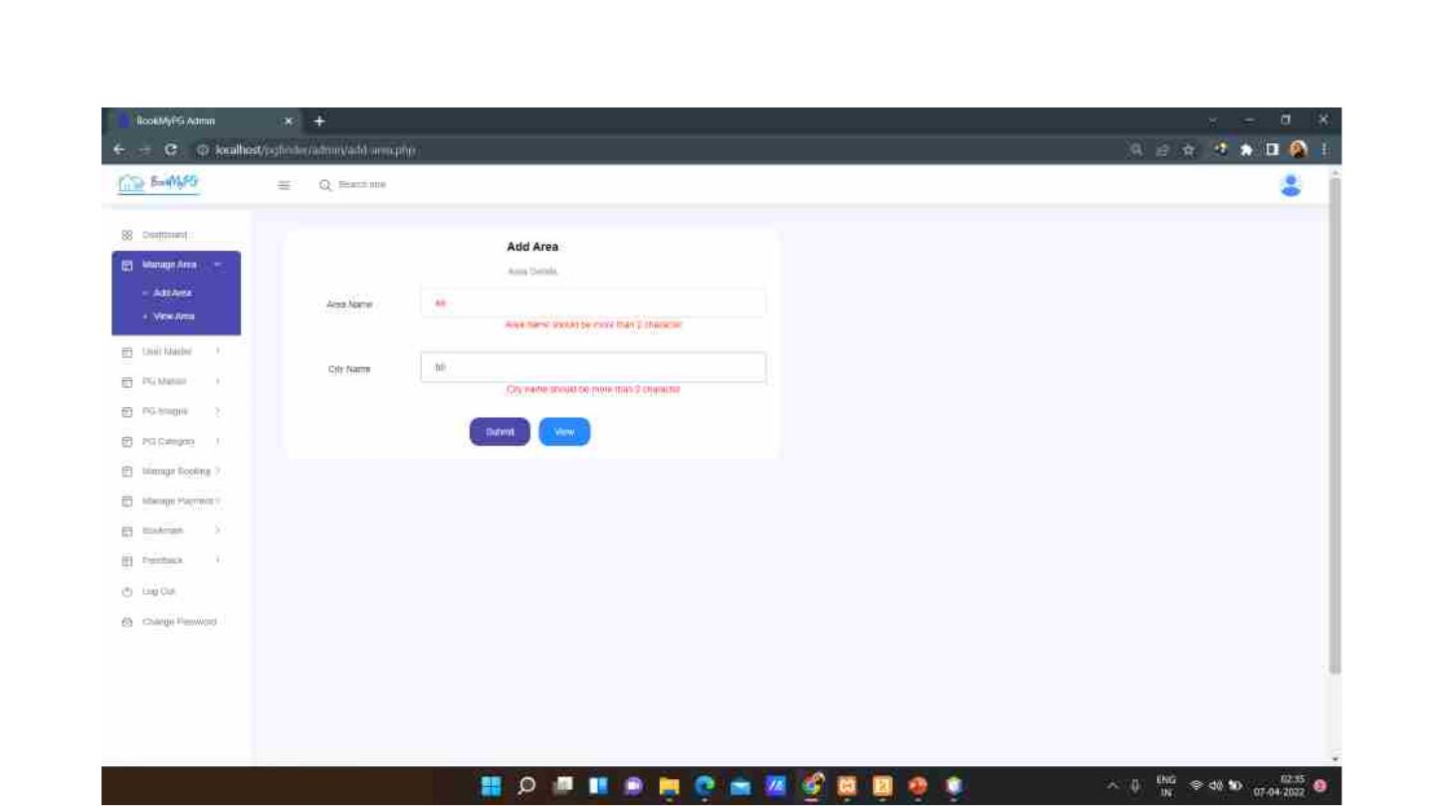

Slide 21

Area page with valid details.

Slide 22
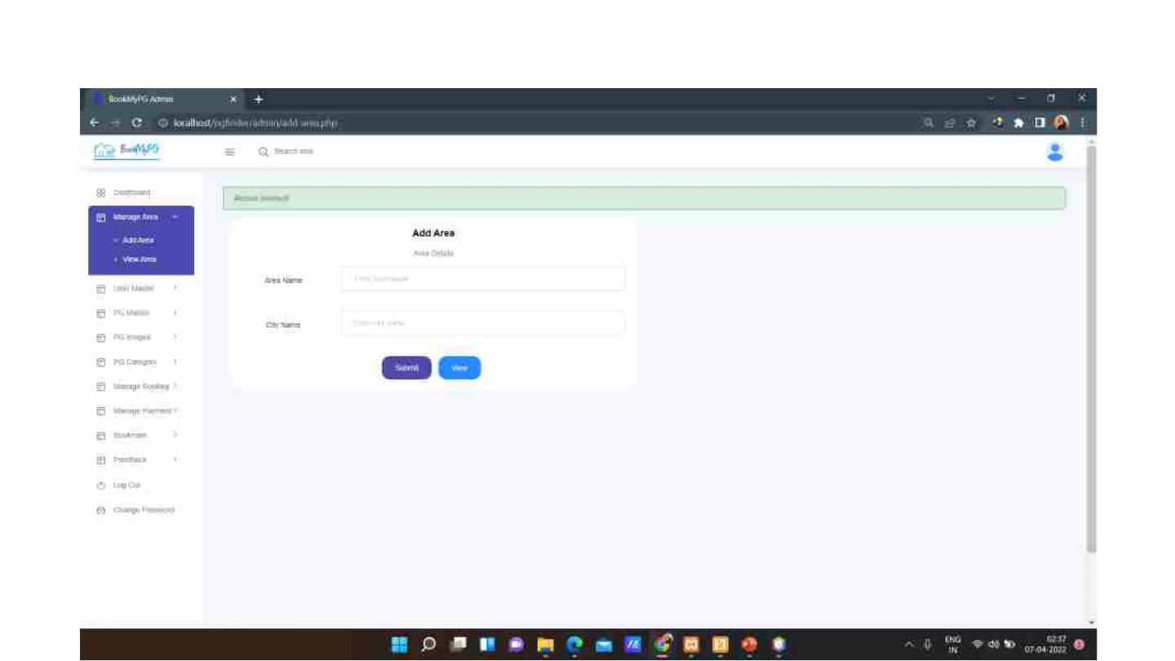
On clicking the submit button, the record gets inserted and Admin is notified.

Slide 23
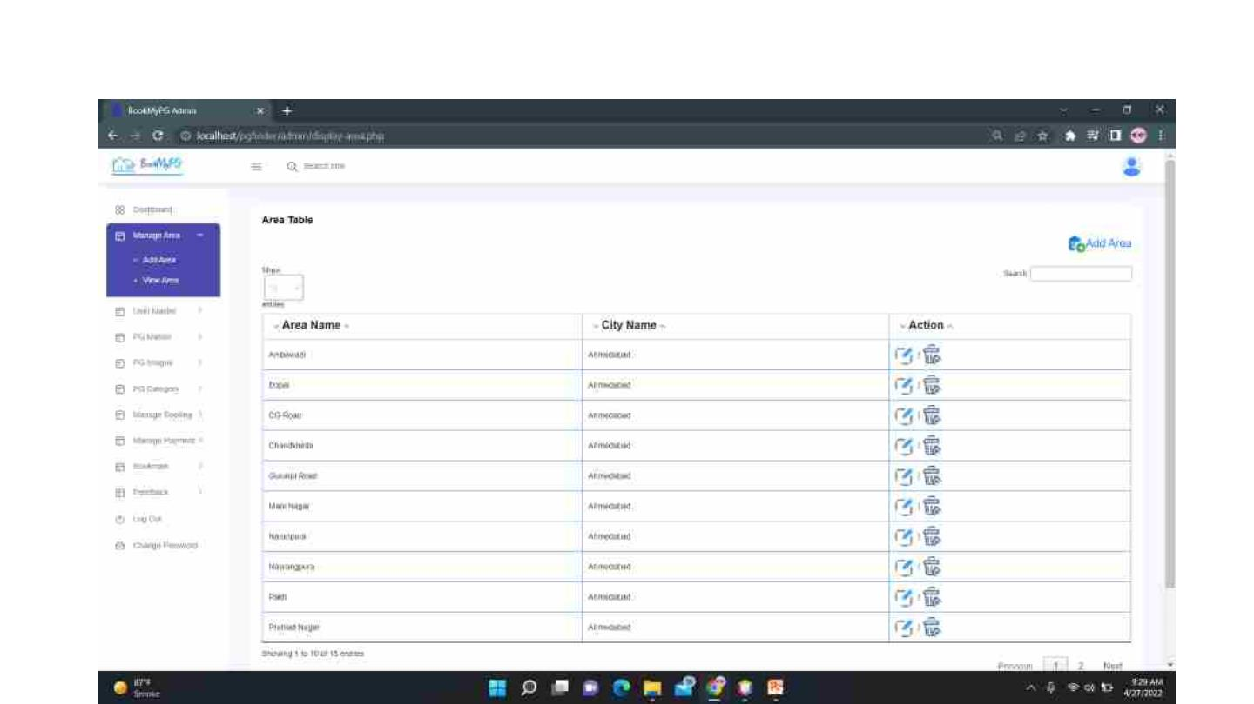
On clicking the view button, Area Table is displayed. An option to Add Area is also provided.
Admin can edit and delete the records as well.

Slide 24
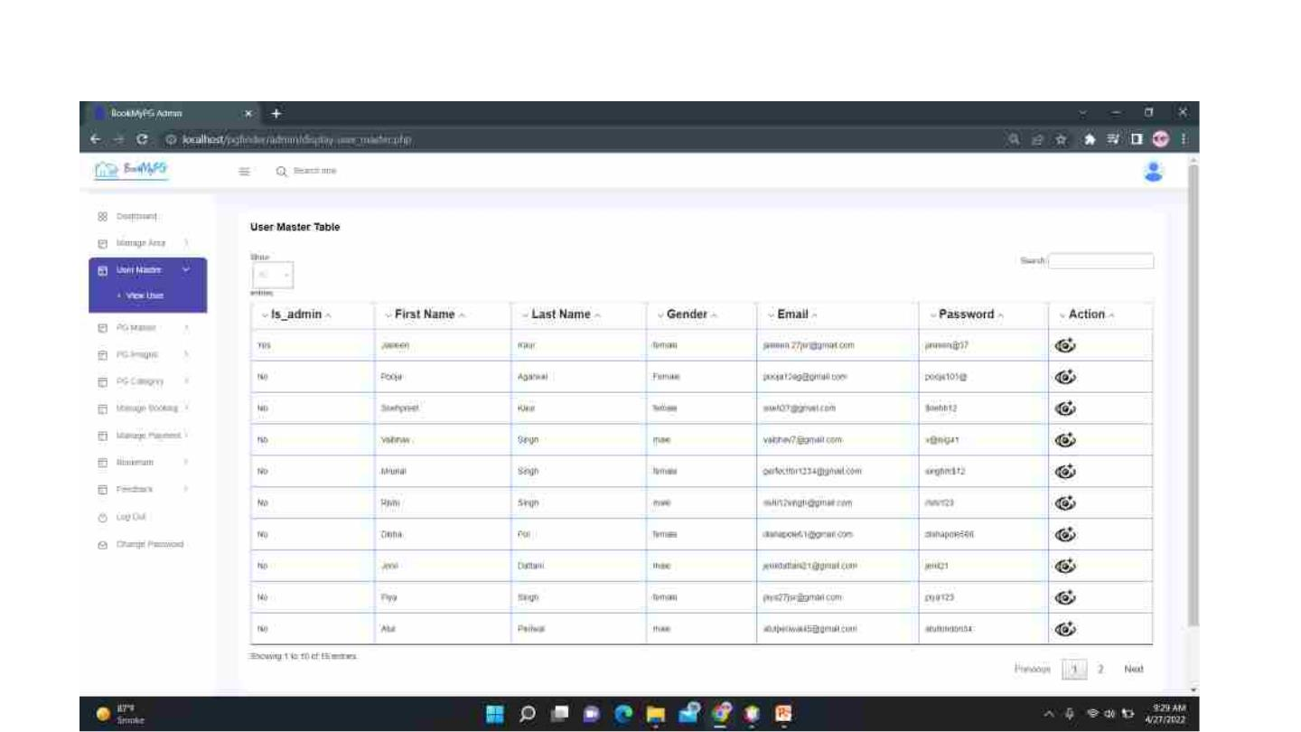
Admin can view the details of the User. On clicking on the view more option, the Admin gets
redirected to a page where entire User details is available.

Slide 25
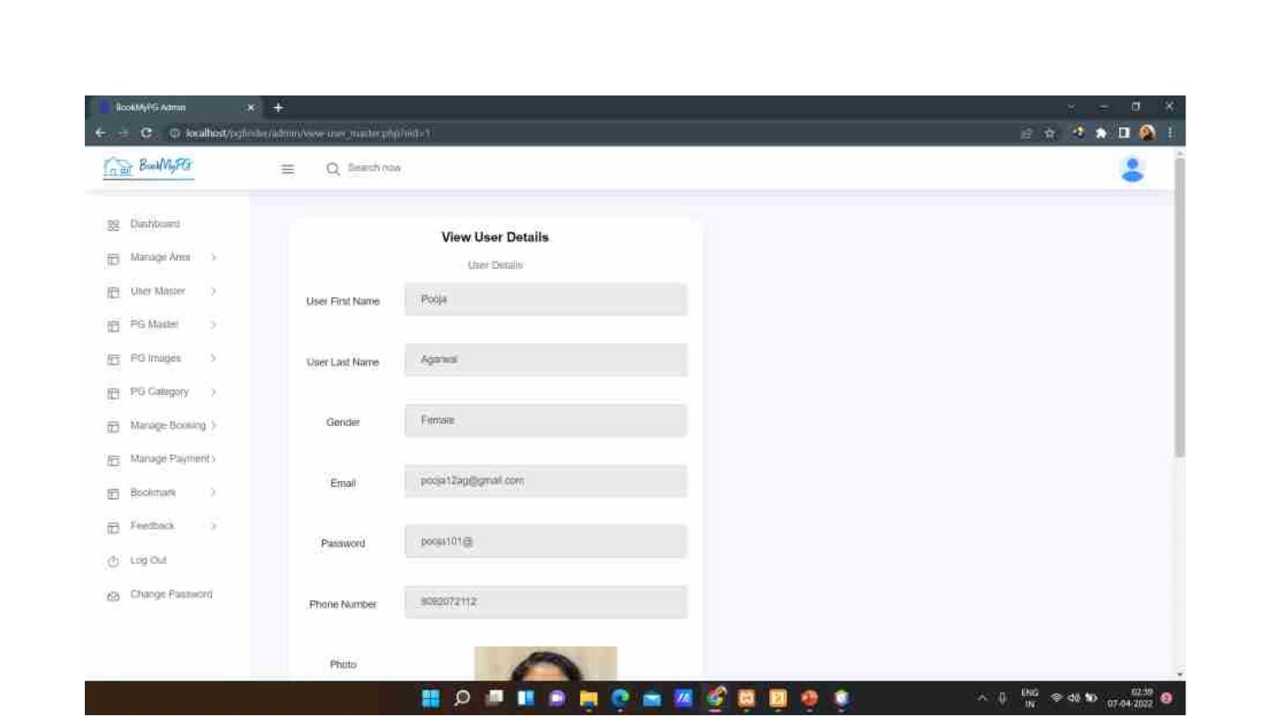
View User details page. Admin can only view the details.

Slide 26
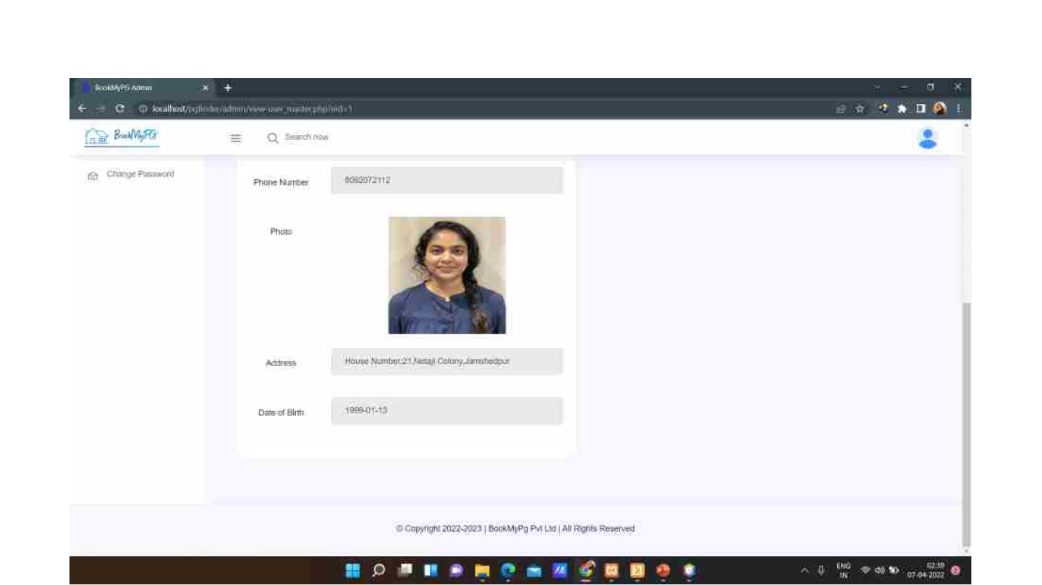

Slide 27
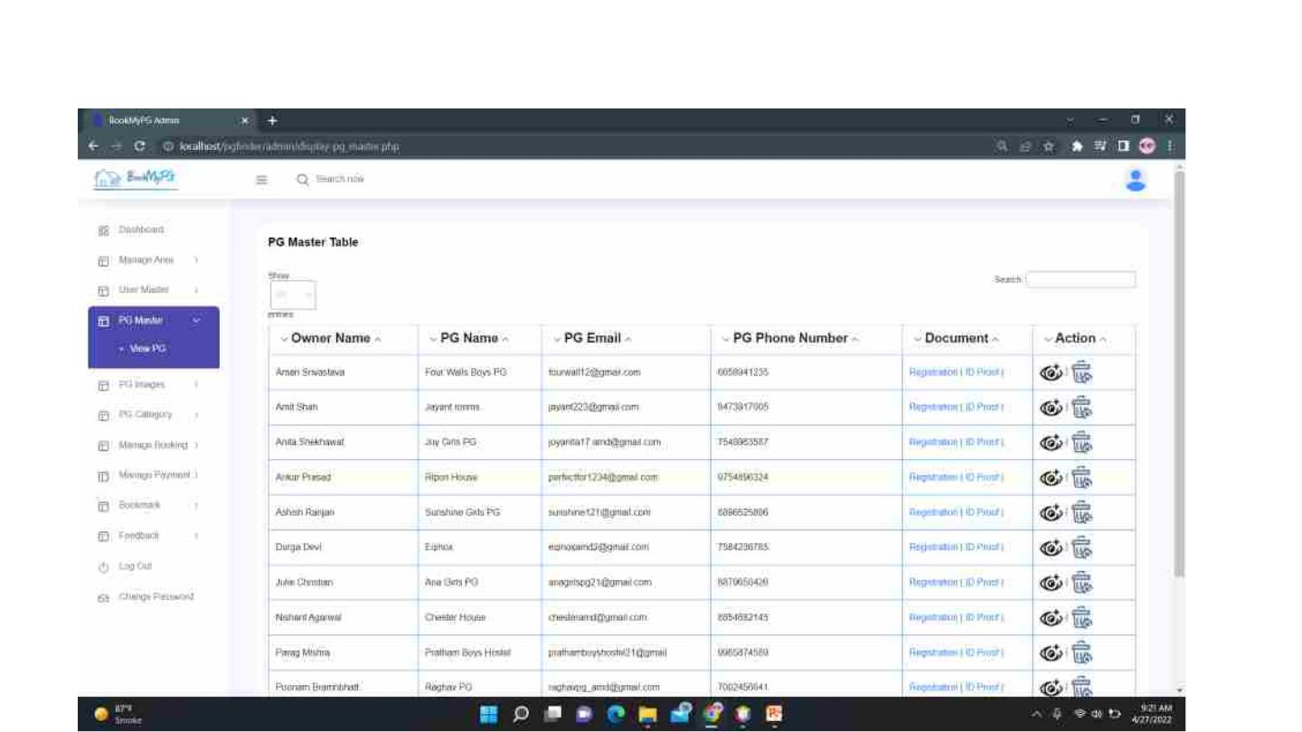
Admin can view the PG details. He can click on view more option to see the entire details of a
particular PG. Admin can also delete PGs.

Slide 28
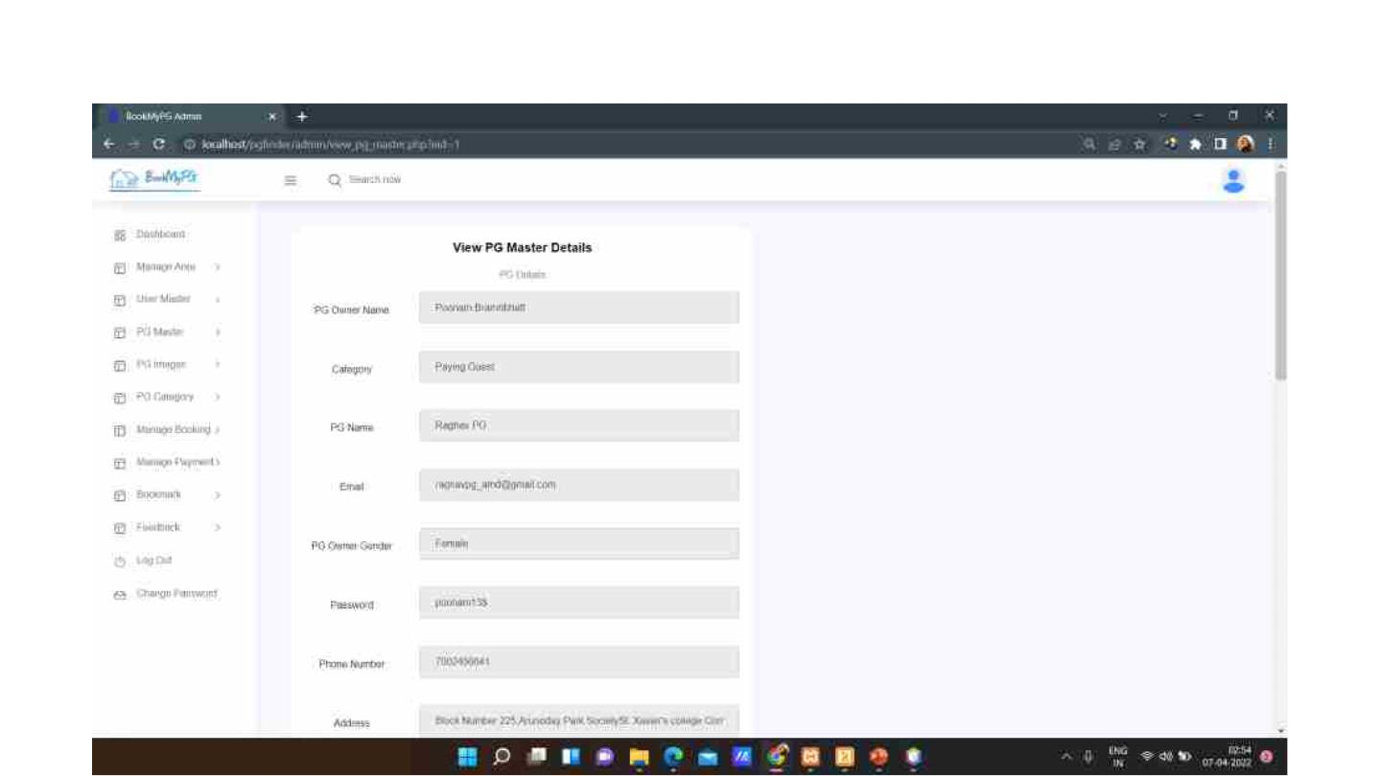
View PG details page. Admin can only view the details.

Slide 29
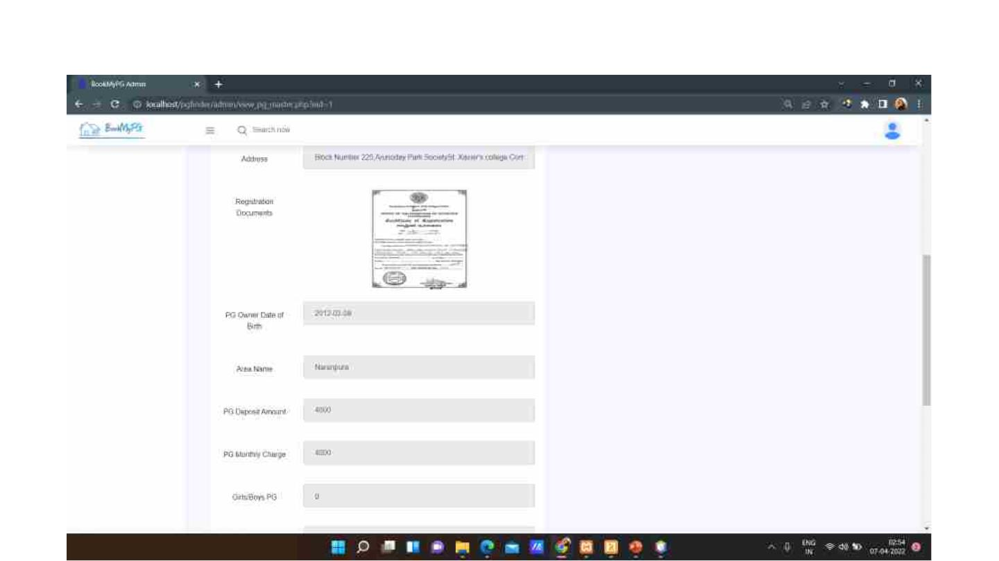

Slide 30
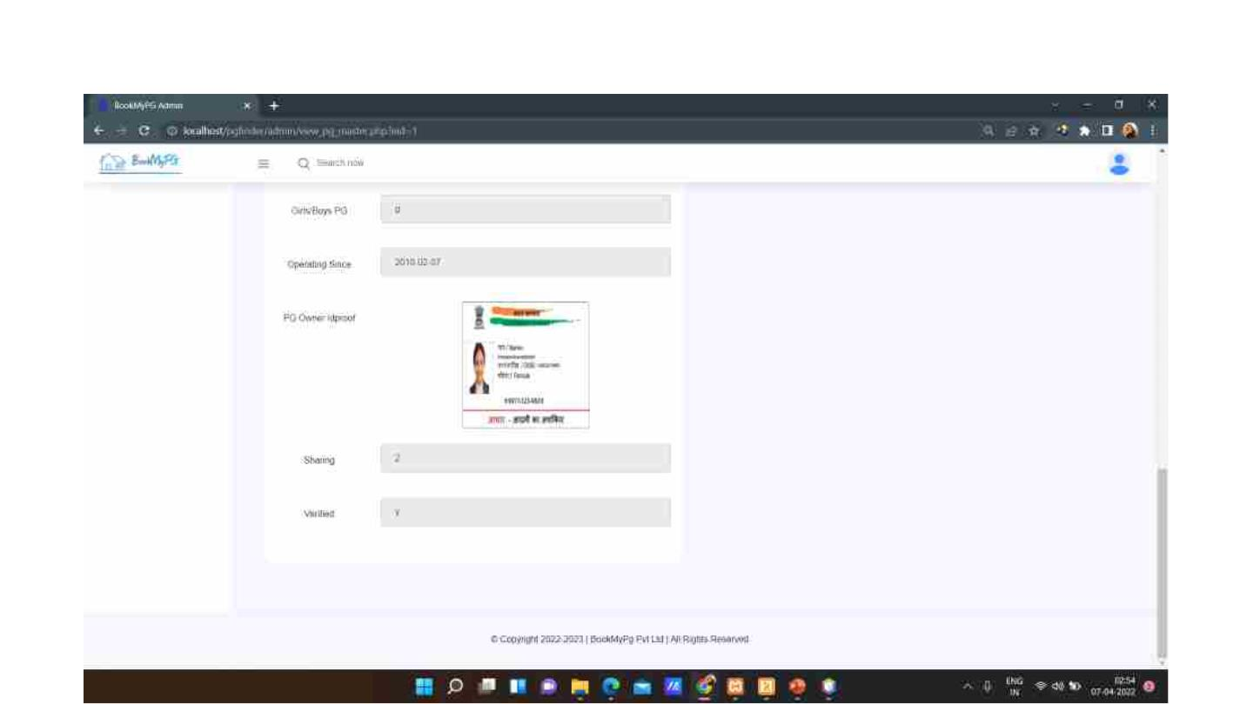

Slide 31
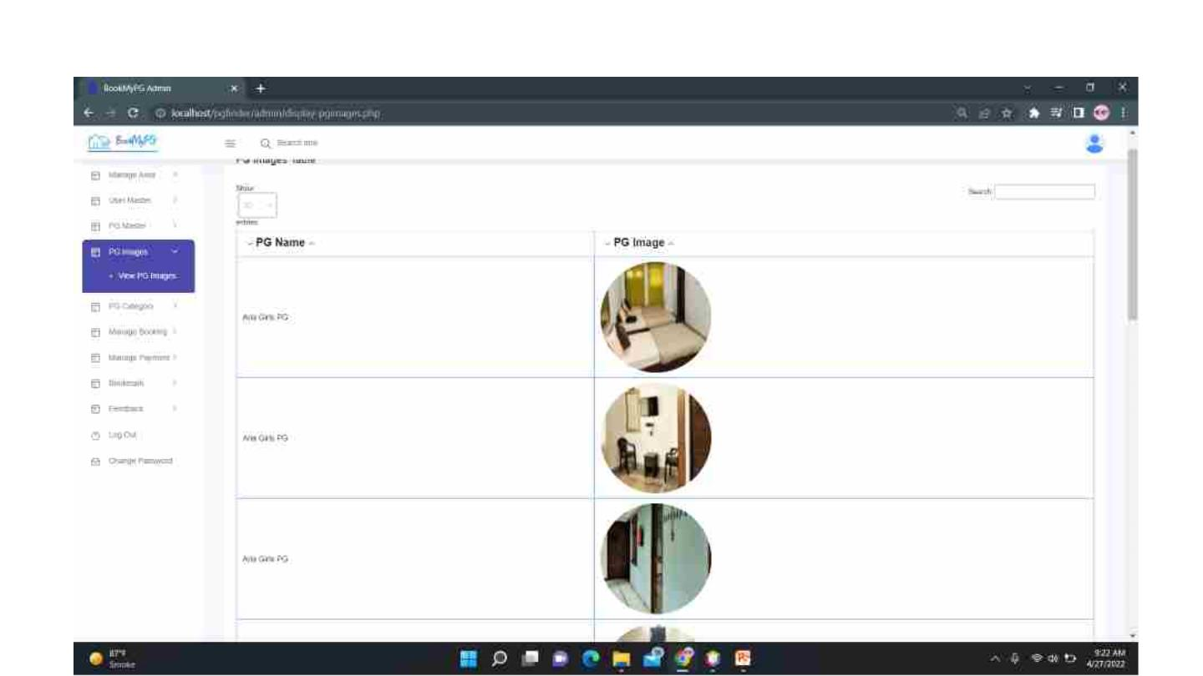
Admin can view PG images.

Slide 32
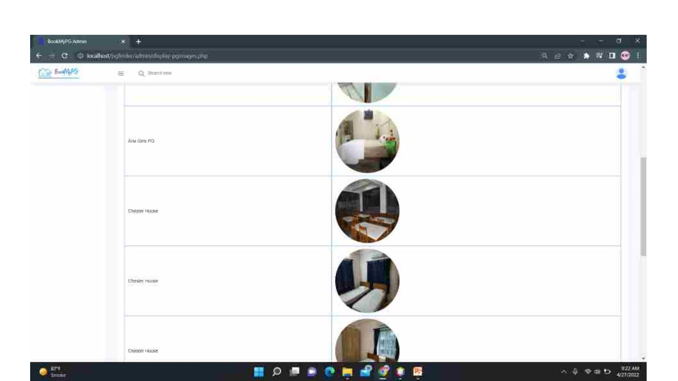

Slide 33
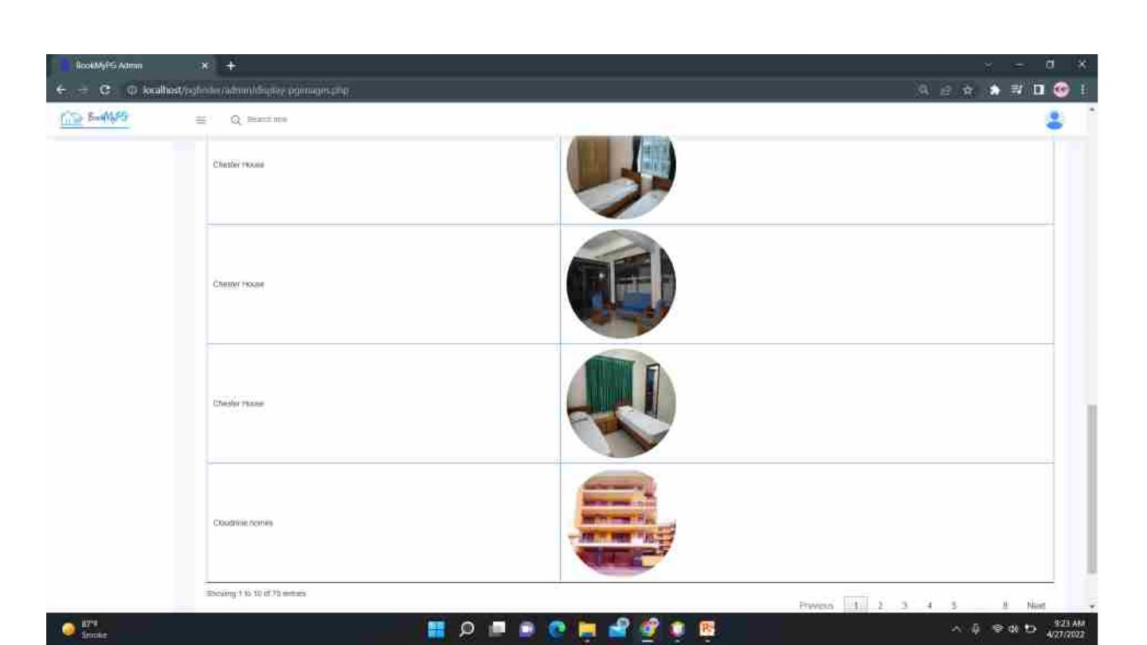

Slide 34
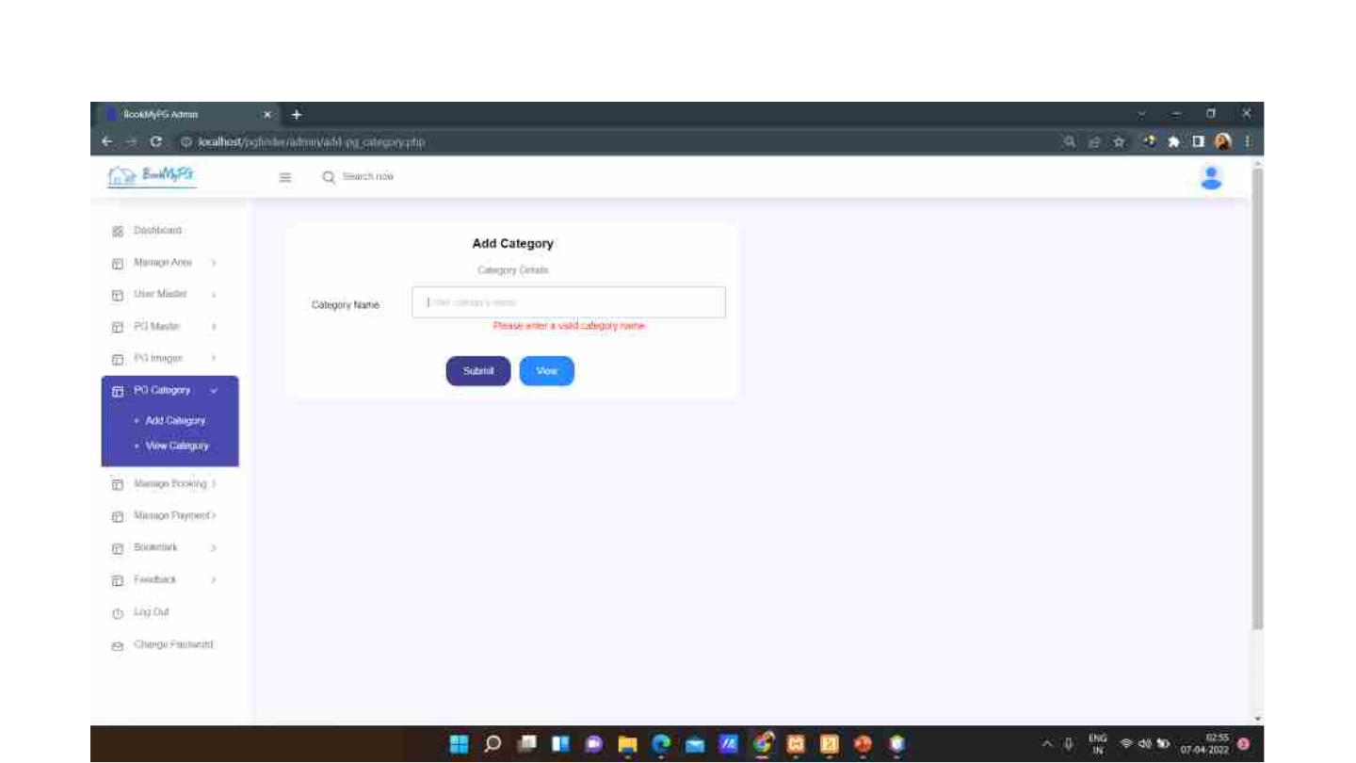
Admin can add PG category.

Slide 35
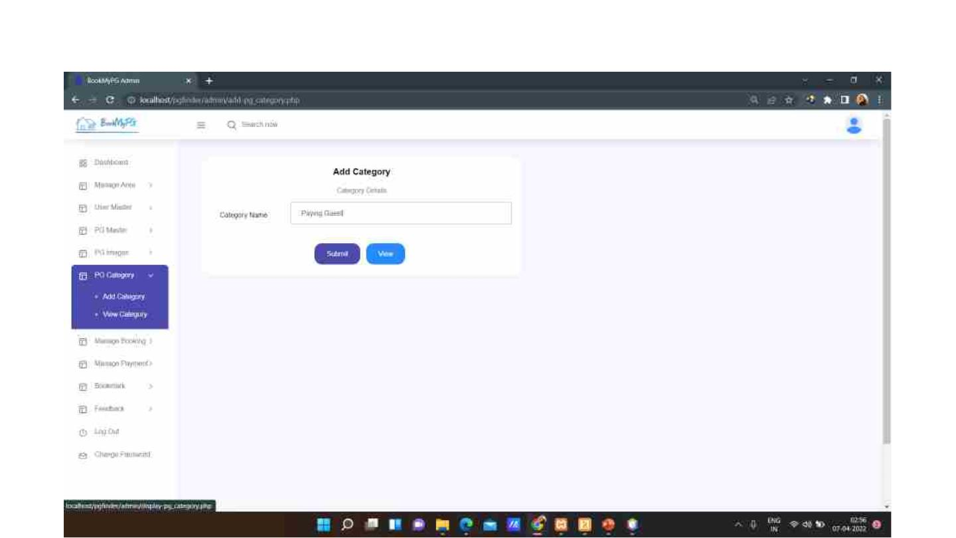
Add category page with valid details.

Slide 36
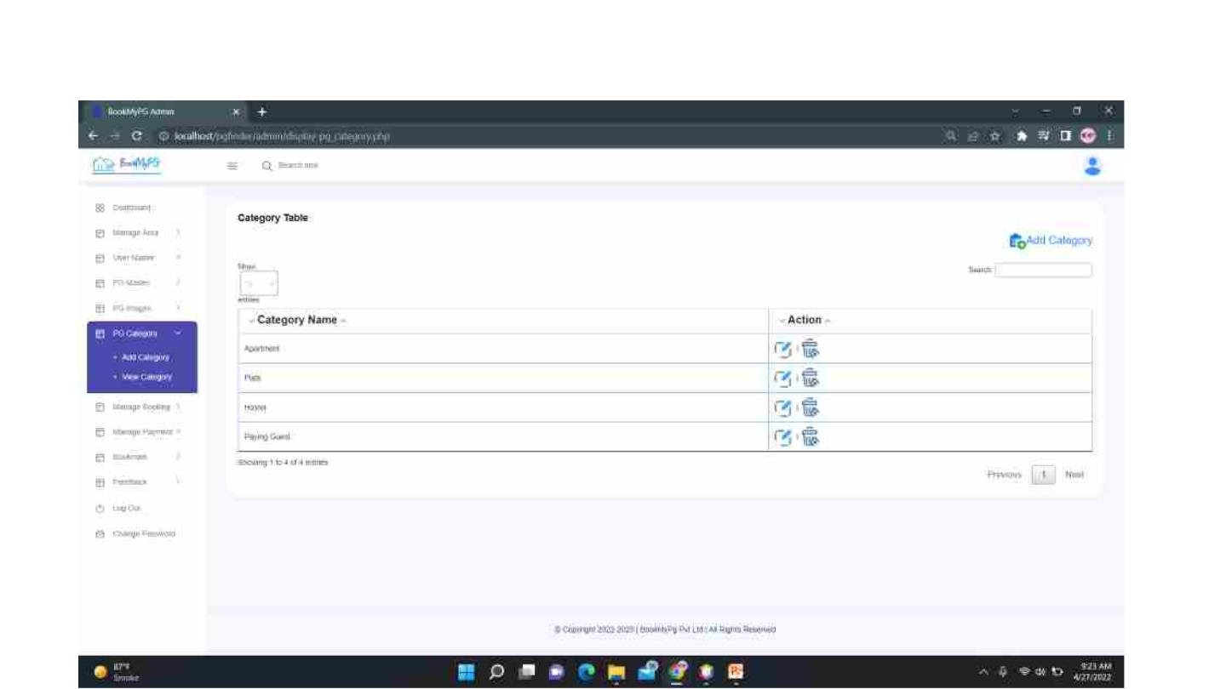
On clicking the submit button, the record gets inserted in the Category Table. An option to Add
Category is also provided. Admin can edit and delete the records as well.

Slide 37
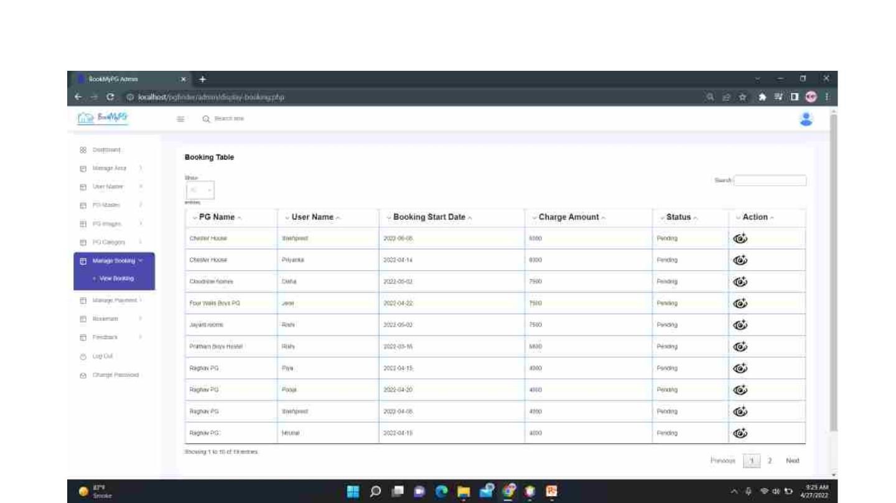
Admin can view bookings on the Users. On clicking on the view more option, the entire booking
details of the User is displayed.

Slide 38
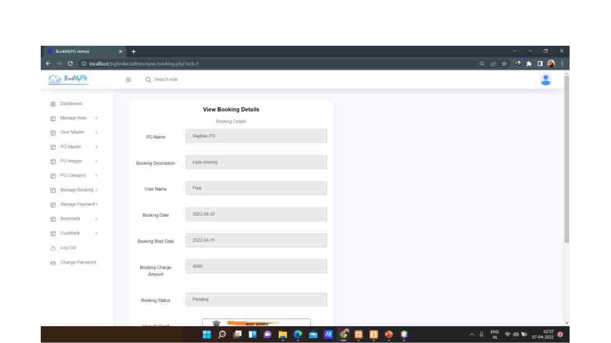
View booking details page.

Slide 39
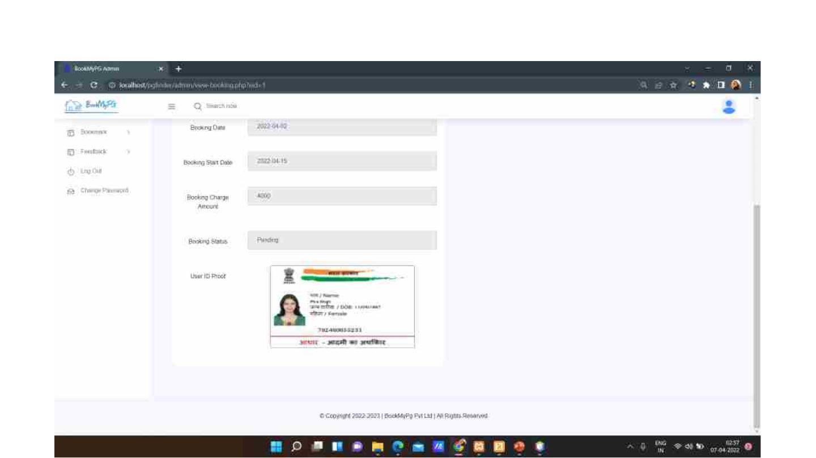
The booking details page also contains User ID Proof.

Slide 40
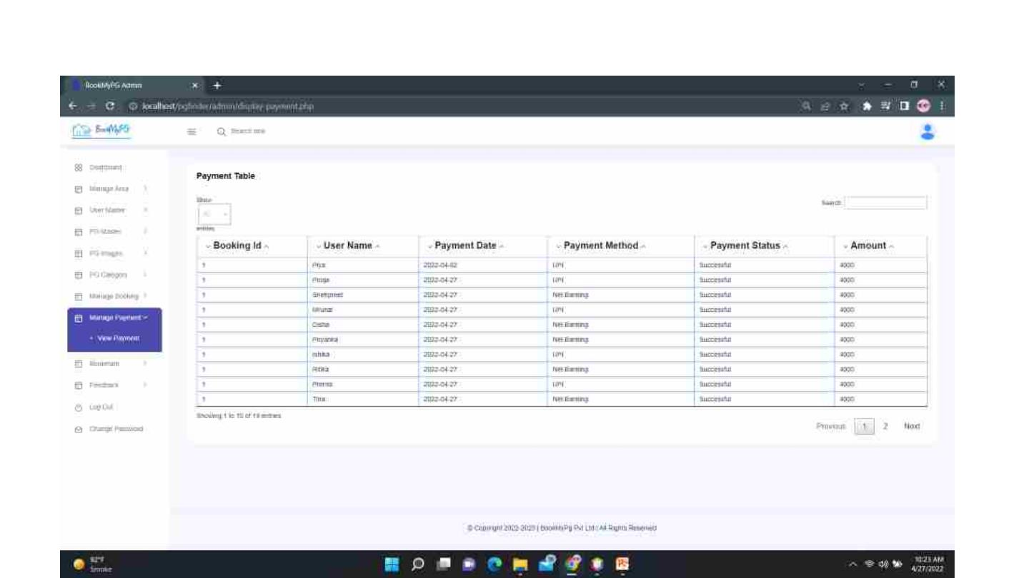
Admin can view payments details.

Slide 41
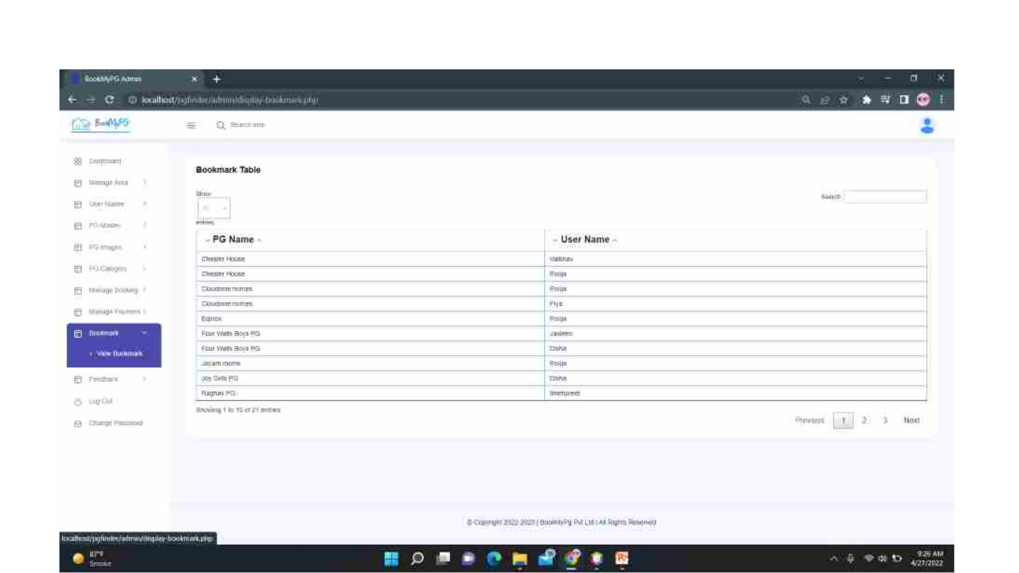
Admin can view the bookmark table.

Slide 42
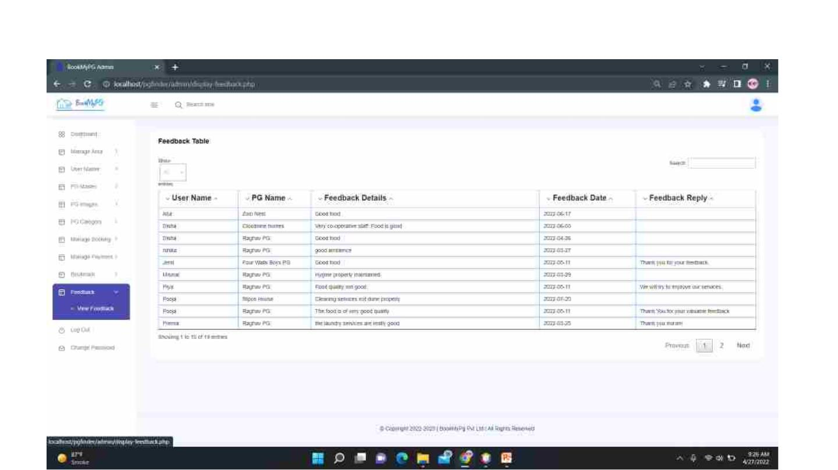
Admin can view the feedback provided by the users and the pely to those feedbacks given by the
PG Owner.

Slide 43
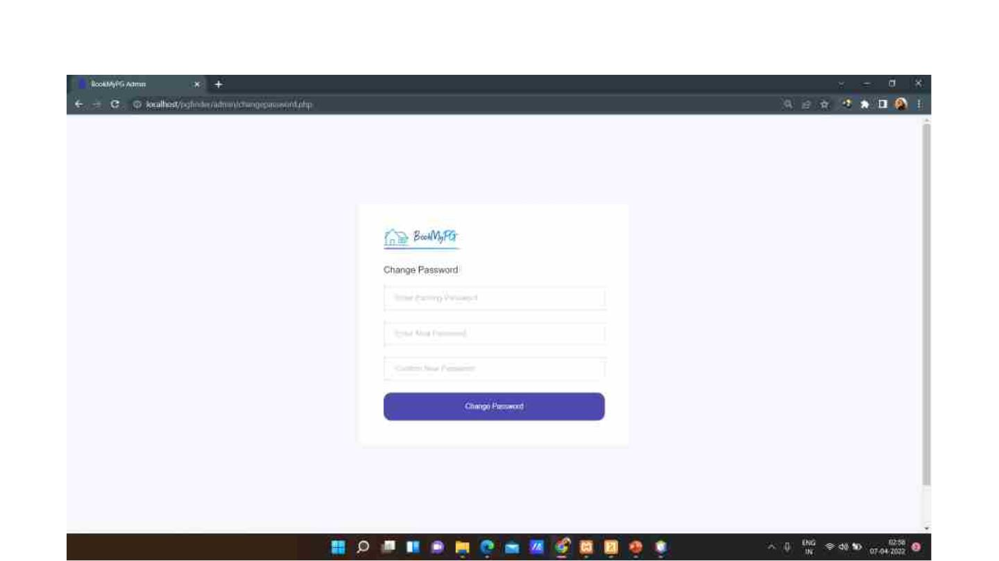
Admin can change password on clicking the Change Password button.

Slide 44
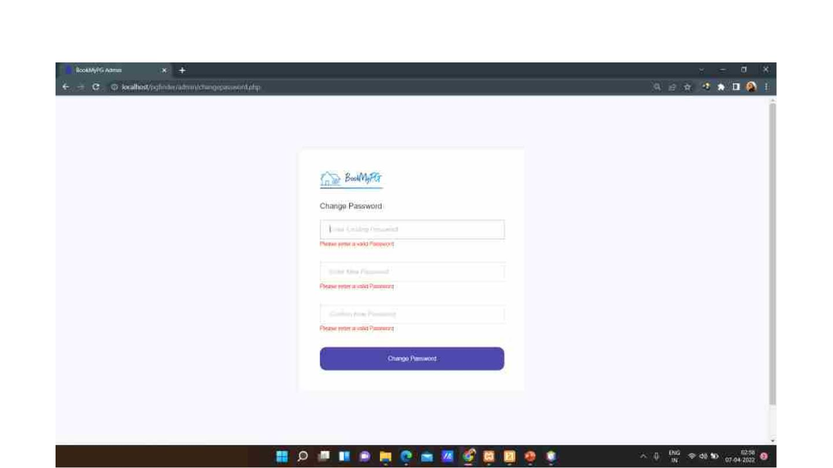
Change Password page with Validations.

Slide 45

Change Password page with valid details.

Slide 46
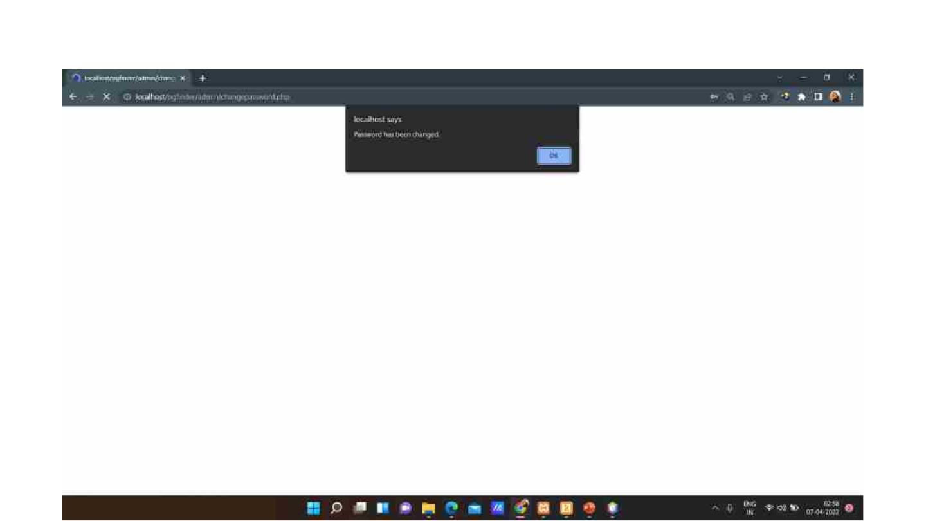
Admin gets the confirmation that the password has changed.

Slide 47
User Panel

Slide 48
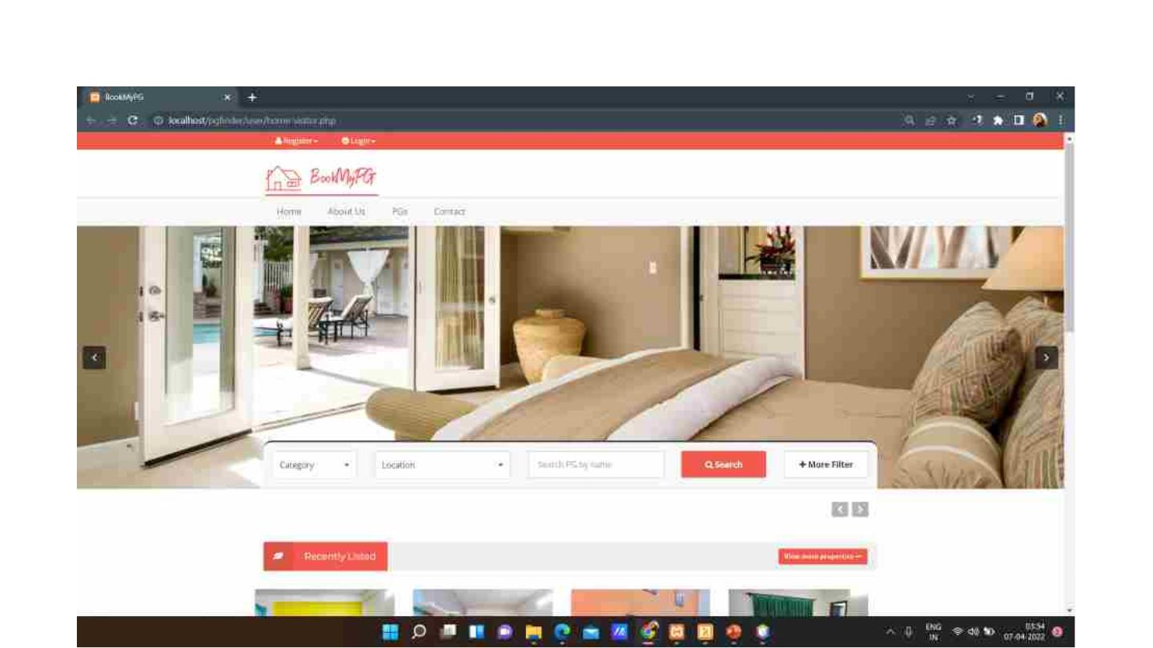
Home page for the Visitor.

Slide 49
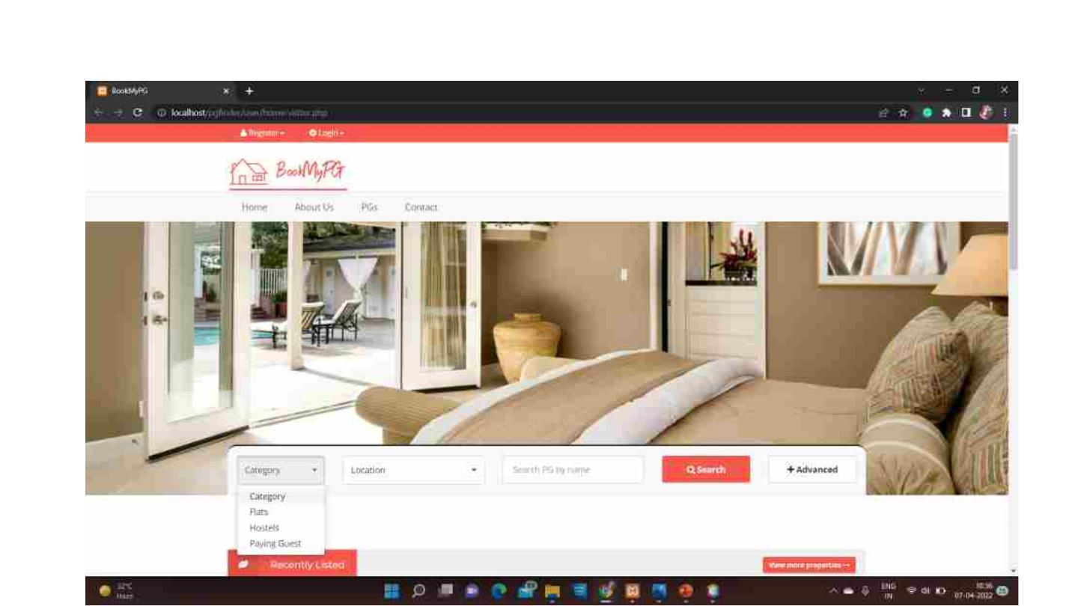
The Visitor can also search the PGs by using various filters provided in the home page.

Slide 50
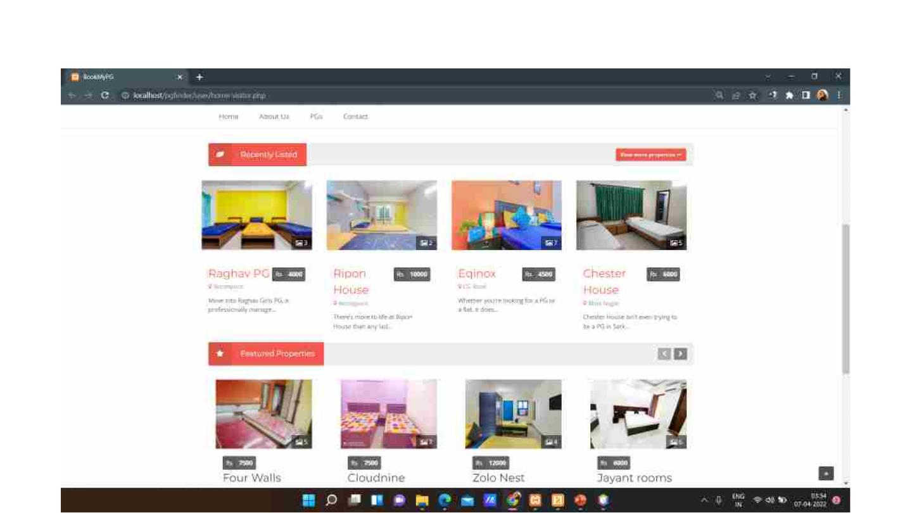
Home page contains list of some of the PGs.

Slide 51
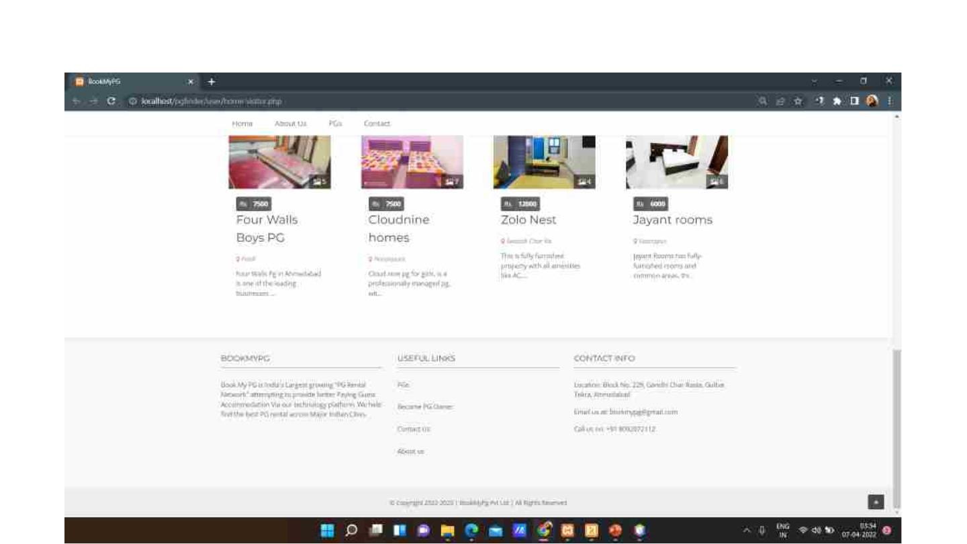
Featured PGs are also displayed in the home page.

Slide 52
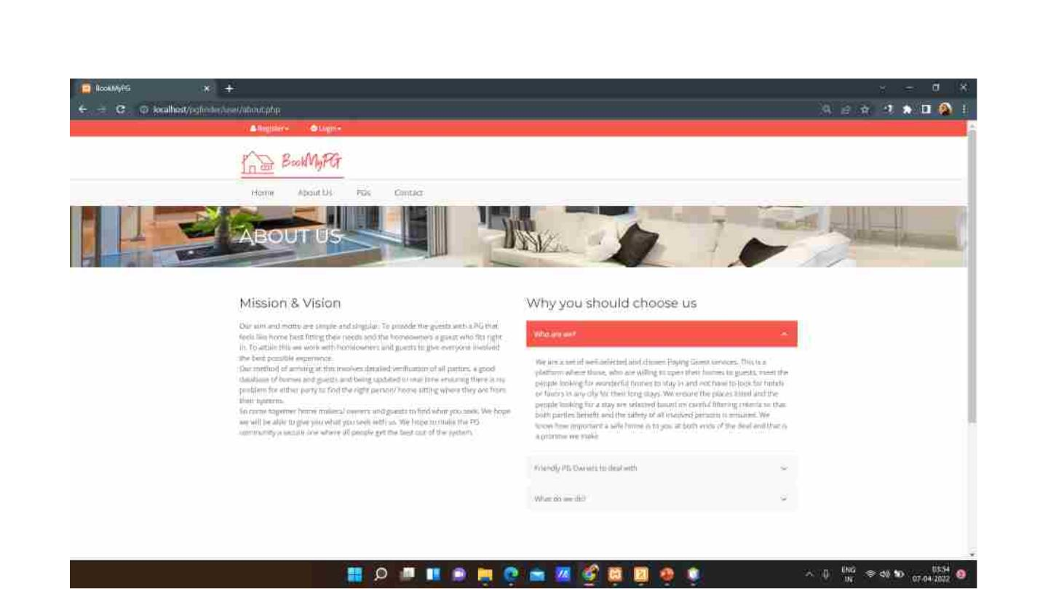
About Us page contains information about the website.

Slide 53
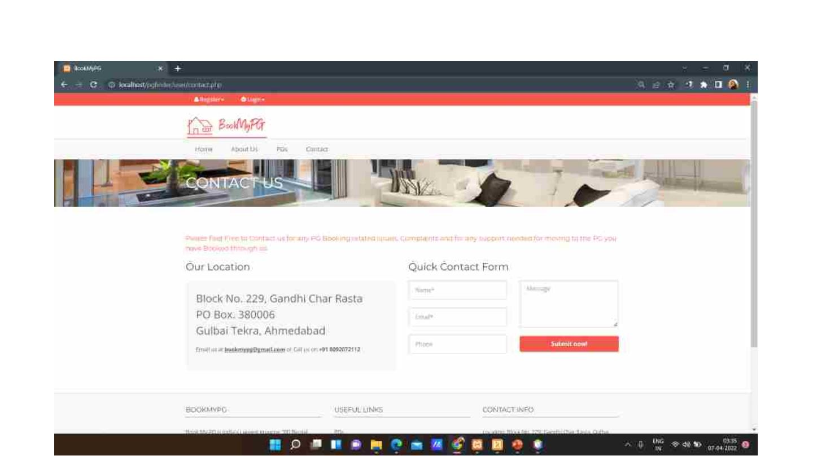
Contact page contains contact information.

Slide 54
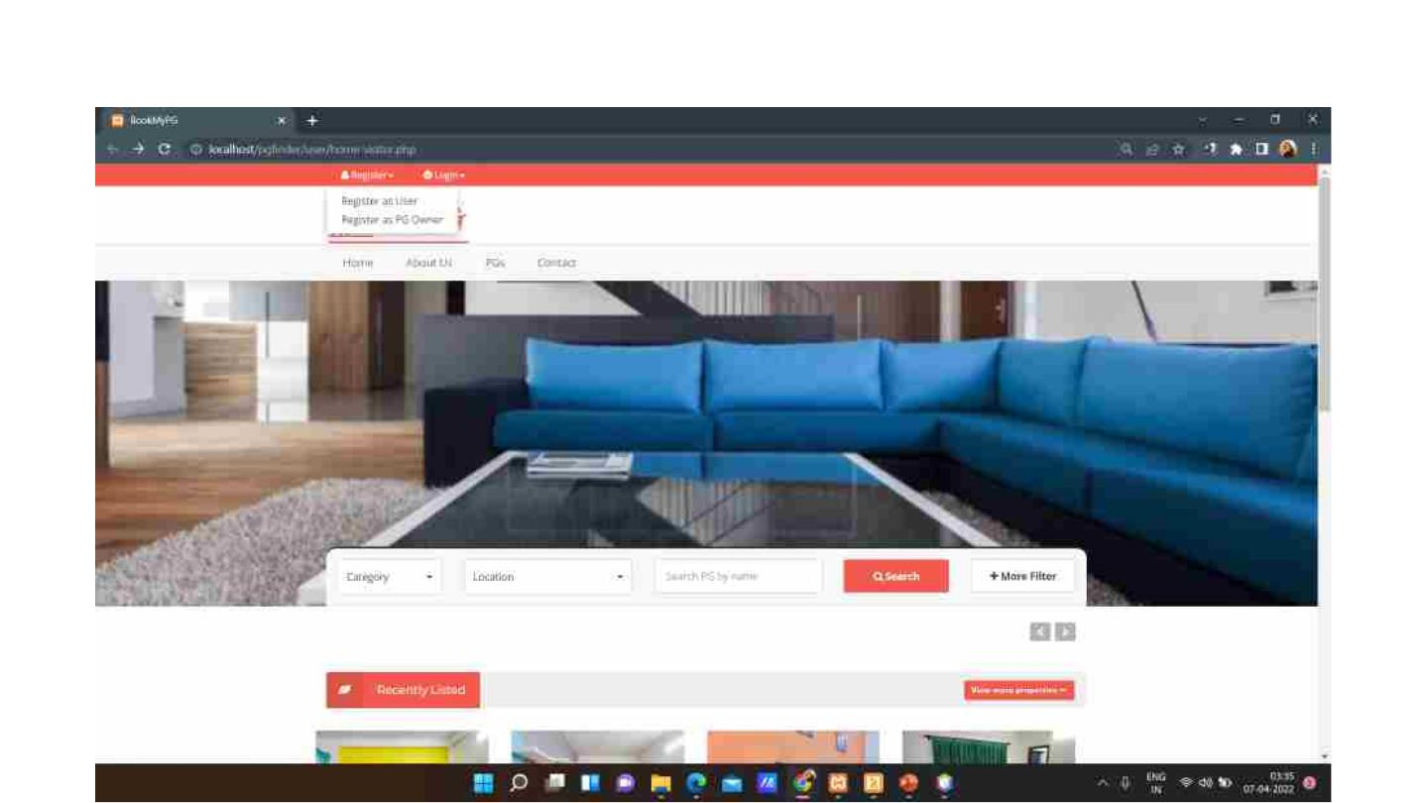
Home page has register option for the Visitor and Login option for the User.

Slide 55
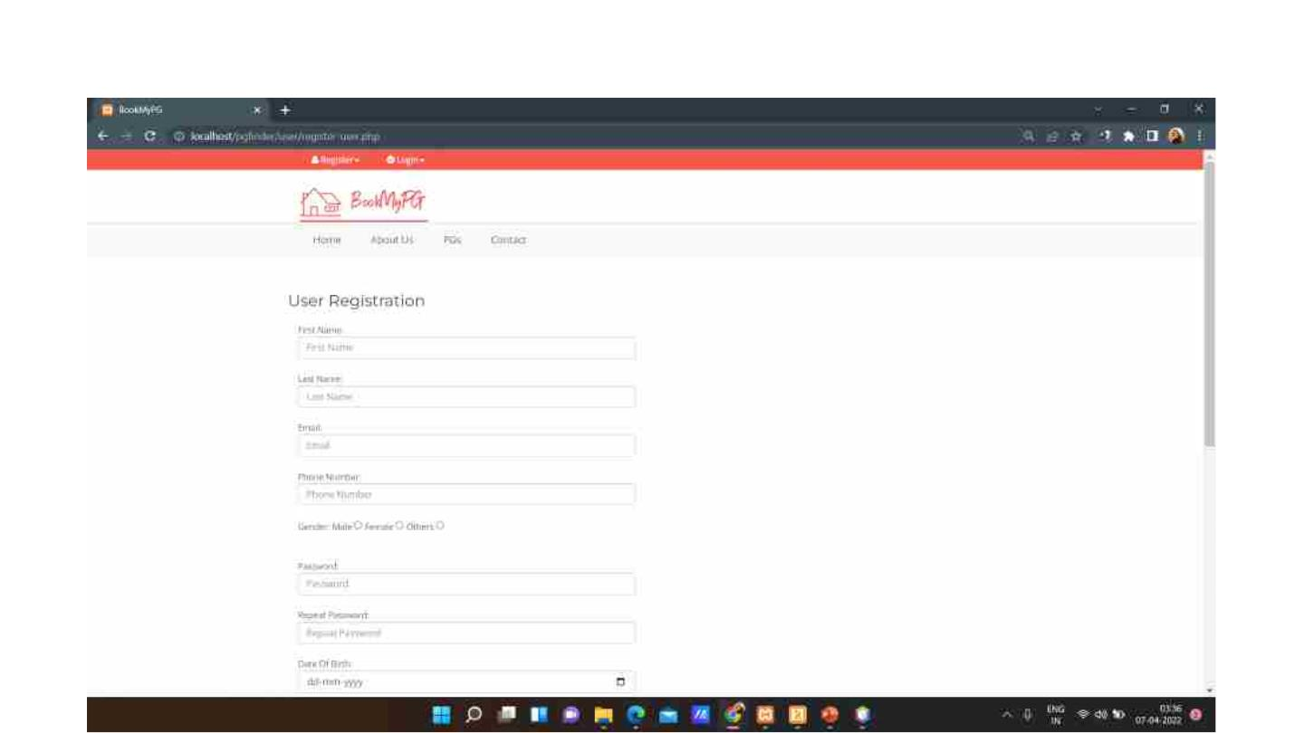
Register page for the User.

Slide 56
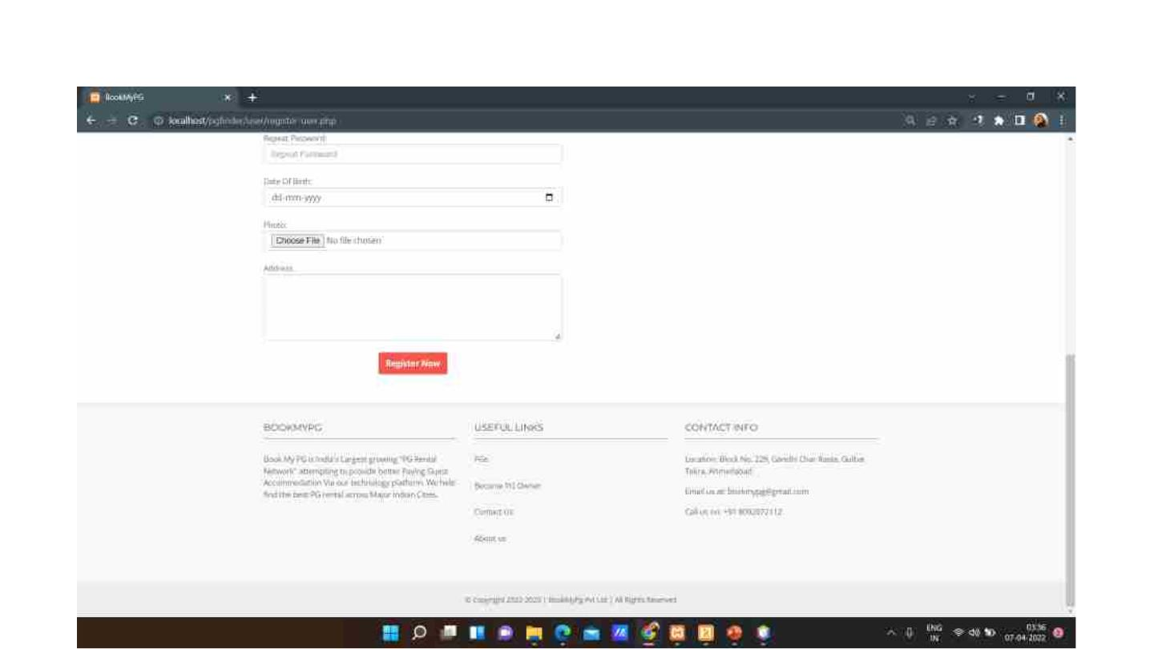

Slide 57
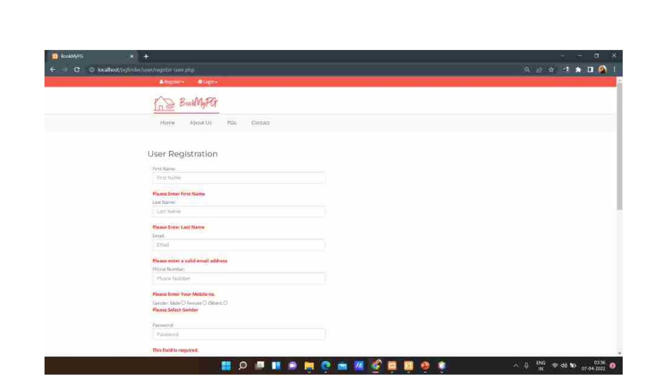
Register page with validations.

Slide 58
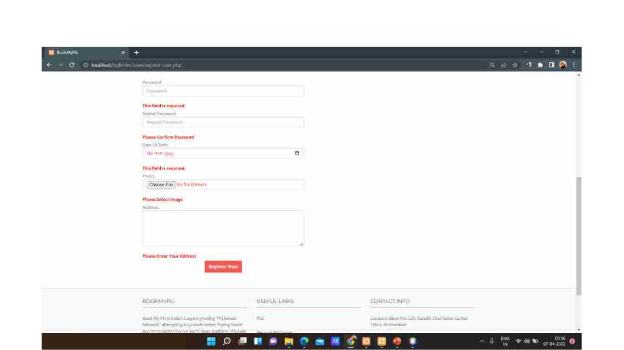

Slide 59
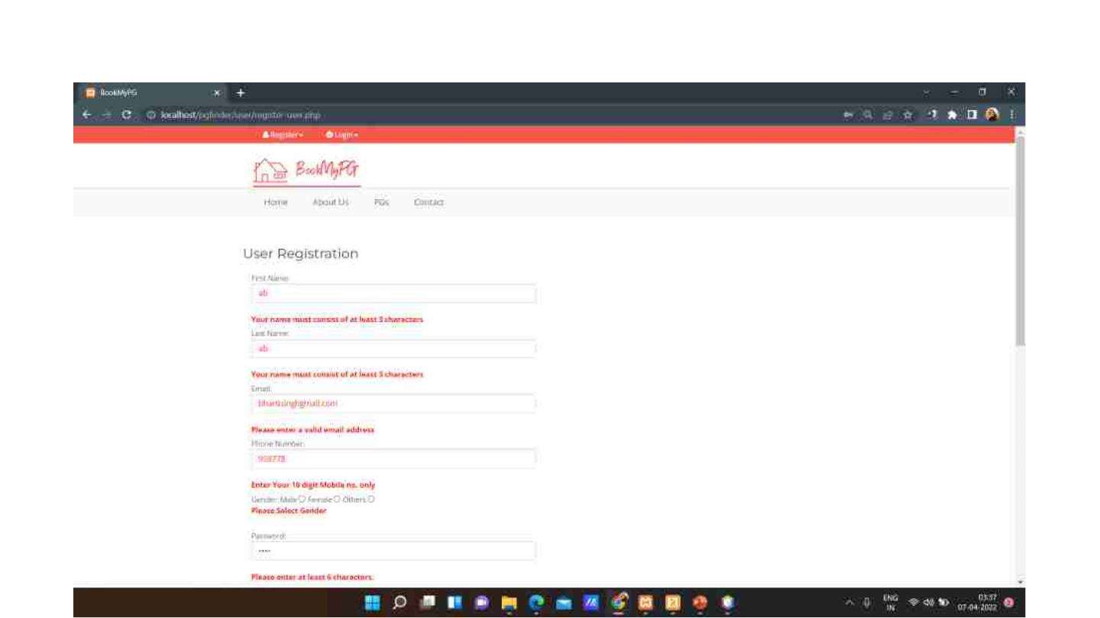

Slide 60
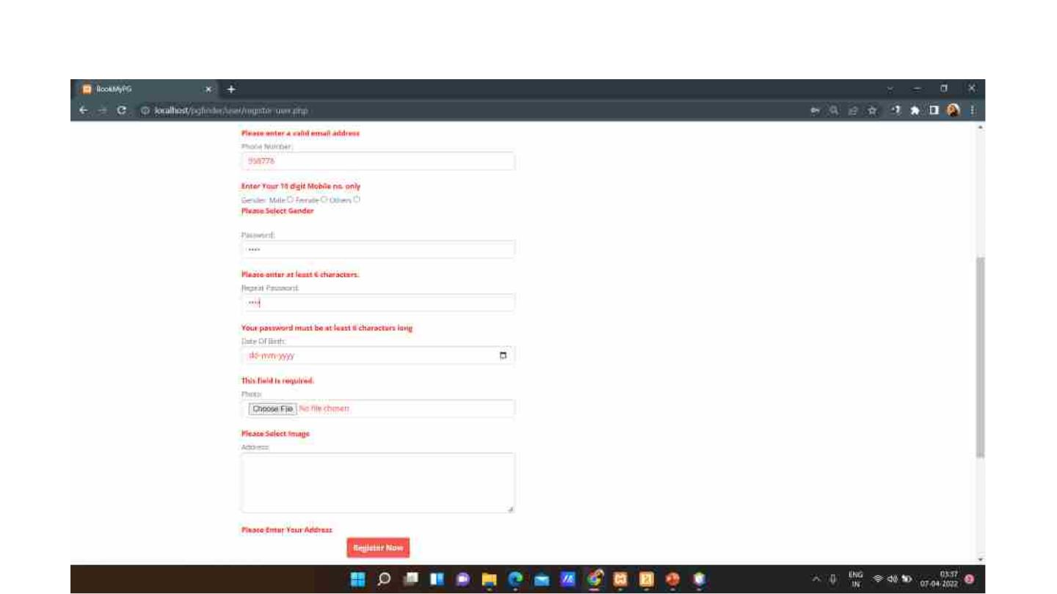

Slide 61

Register page with valid credentials.

Slide 62


Slide 63
Register page for the PG Owner.

Slide 64


Slide 65

PG Owner registration form with validations.

Slide 66


Slide 67


Slide 68


Slide 69

Login page for the User.
This page also contains the forgot password option.

Slide 70

Login page with validations.

Slide 71

Login page with valid credentials.

Slide 72

Forgot password page for the User.

Slide 73

Forgot password page with validations.

Slide 74

Forgot password page with valid credentials.

Slide 75

When the User clicks on the Request Password Option, an alert message is displayed which says
that the new password has been sent to his email id.

Slide 76

After successful login, the User is directed to the home page.

Slide 77

An option to view bookmarks, booking and change password is also provided. User can also click on
logout button to log out.

Slide 78

From the home page, User can search PGs using various filters.

Slide 79

Home page also lists a few PGs.

Slide 80

Featured PGs are also displayed in the home page.

Slide 81

This page contains the list of all the PGs for the User to view.
An option to search is also provided with various filters.

Slide 82


Slide 83


Slide 84


Slide 85

When the User clicks on a particular PG, he is directed to a page which shows detailed information
about the PG. User also gets an option to Book and Bookmark the PG.

Slide 86

The page lists amenities provided by the PG and feedback provided by the other Users.

Slide 87

This page also contain a list of related PGs.

Slide 88

On clicking on the Book Now button, Booking page is opened.

Slide 89

User will enter the booking details in this page.

Slide 90

Booking page with validations.

Slide 91

Booking page with valid credentials.

Slide 92

When User clicks on Book Now, he will be directed to the payment page.

Slide 93


Slide 94

View booking page for the User.
This page also contains an option for the User to give feedback.

Slide 95

Give feedback page for the User.

Slide 96


Slide 97

View bookmark page for the User.

Slide 98

Change password page for the User.

Slide 99

Change password page with validatios.

Slide 100

Change password page with valid details.

Slide 101

Confirmation that the password has been sent to your email.

Slide 102

PG Owner Panel

Slide 103

This is the login page for the PG Owner.

Slide 104

Login page with validation.

Slide 105


Slide 106

Login page with valid credentials.

Slide 107

Forgot password page for the PG Owner with validations.

Slide 108

Forgot password page for the PG Owner with valid credentials.

Slide 109

Password sent to the PG Owner’s email id.

Slide 110

Confirmation that password has been sent to the email id.

Slide 111

Home page for the PG Owner.

Slide 112

Home page also contains option for logout and change password.

Slide 113

PG Details of the PG Owner logged in.

Slide 114

Details of the PG.

Slide 115


Slide 116


Slide 117


Slide 118

This page displays the PG images and provies the owner an option to add new images.

Slide 119

Page to add PG images.

Slide 120

Add PG images page with validations.

Slide 121

Page to view PG bookings.

Slide 122

This page displays the entire booking details of the user.

Slide 123


Slide 124

Page to display payment details.

Slide 125

Page to display feedback details.

Slide 126

Page for PG owner to reply to feedbacks.

Slide 127

Change password page for the PG Owner.

Slide 128

Change password page with validations

Slide 129

Change password page with valid credentials.

Slide 130

Confirmation that the password has been changed.

Slide 131

Reports
• Category and gender wise PG report.
• Category and area wise PG report.
• User wise bookmark PG report.
• Category and monthlycharge and gender wise PG report.
• Category, area and gender wise PG report.
• Gender wise PG report.
• PG wise feedback report.
• User wise PG booking report.
• User wise PG feedback report.
• Date wise PG booking report.
• Gender and sharing wise PG report.
• PG wise booking report.
• PG wise bookmark report.

Slide 132

Category and gender wise PG report

Slide 133

Print view of Category and gender wise PG report

Slide 134

Excel view of Category and area wise PG report

Slide 135

Category and area wise PG report

Slide 136

Print view of Category and area wise PG report

Slide 137

Excel view of Category and area wise PG report

Slide 138

User wise bookmark PG report

Slide 139

Category and monthlycharge and gender wise PG report

Slide 140

Category, area and gender wise PG report

Slide 141

Gender wise PG report

Slide 142

PG wise feedback report

Slide 143

User wise PG booking report

Slide 144

User wise PG feedback report

Slide 145

Date wise PG booking report

Slide 146

Gender and sharing wise PG report

Slide 147

PG wise booking report

Slide 148

PG wise bookmark report

Slide 149

THANK YOU

